Slide 1
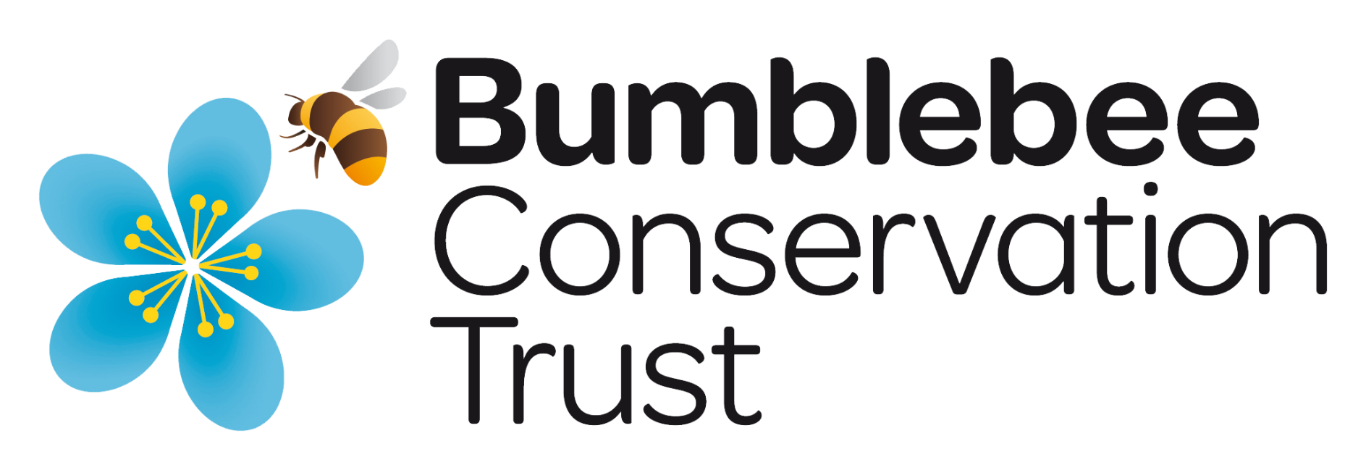
Pollination
Buzzing with bumblebees
bumblebeeconservation.org

Slide 2
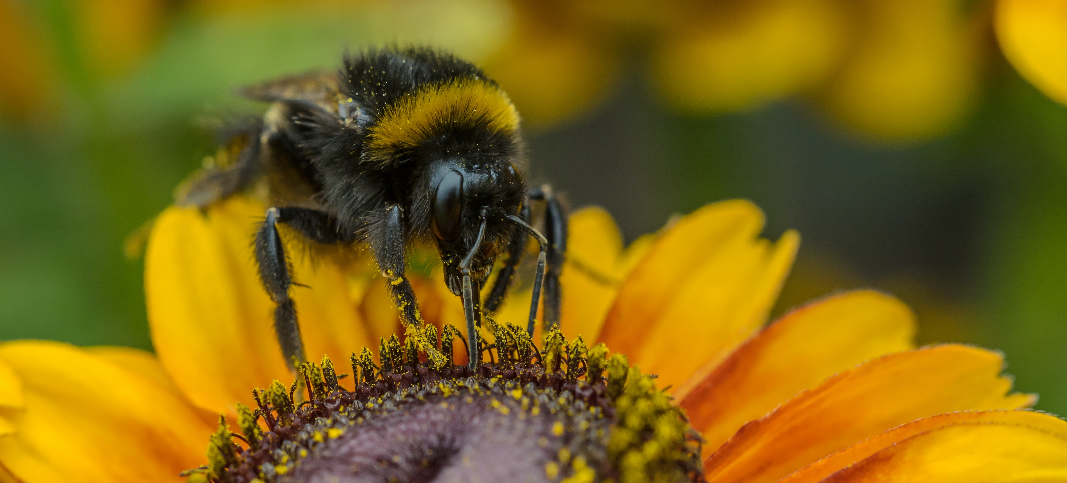
Why do bumblebees visit flowers?
Notes:
Discuss why bumblebees visit flowers. What are they doing? Has anyone watched a bumblebee on a flower before? For food, to feed their young, for survival.

Slide 3
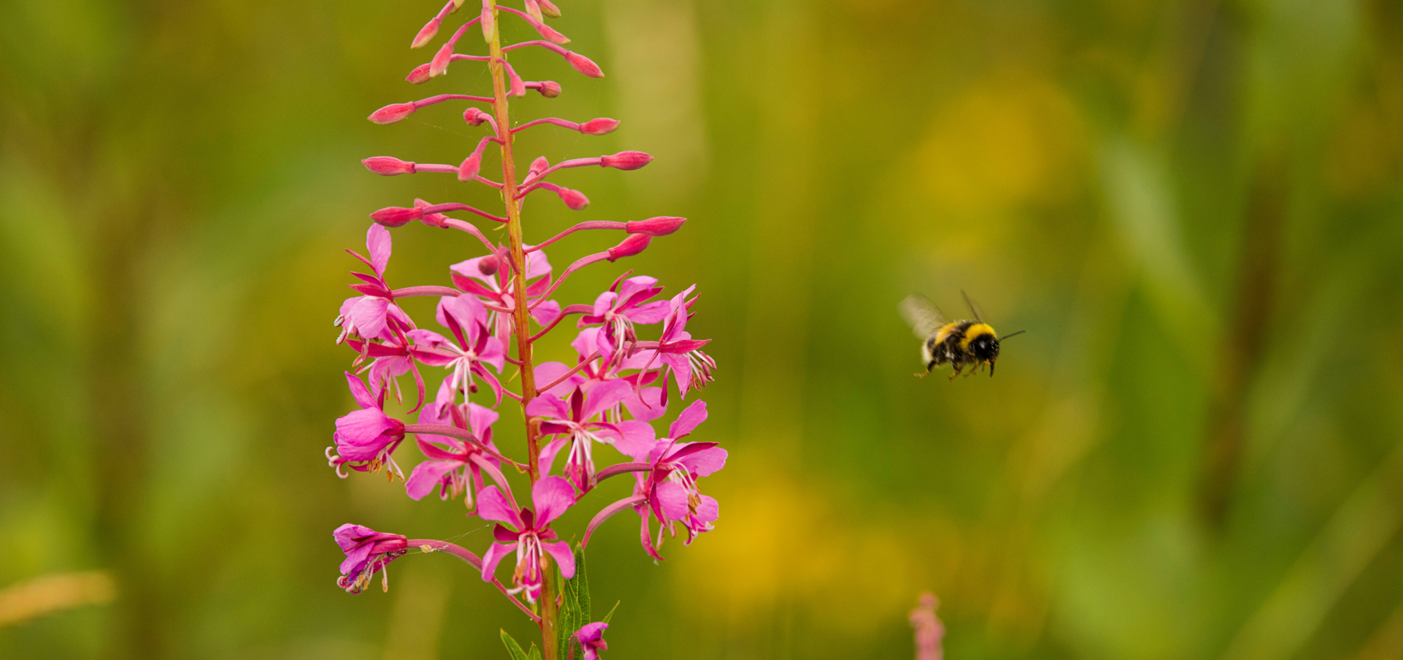
Let's explore the video.
What do you see? What are the bumblebees doing?
Notes:
Discussion points from the video: What can they see the bumblebees doing?
Can they see their long tongues used for drinking nectar? Look to see the pollen baskets on the bumblebees’ hind legs, where pollen is collected.

Slide 4
Flowering plants produce a sweet liquid called nectar.
Bumblebees visit flowers to drink nectar for energy.
slurp
slurp
slurp
Notes:
Bumblebees drink nectar from flowers for energy. Bumblebees have varying length tongues, so that different species can access nectar from different flowers. Some bumblebees have tongues as long as their whole body, up to 2cm long. Can the pupils imagine having tongues that touch the floor?

Slide 5
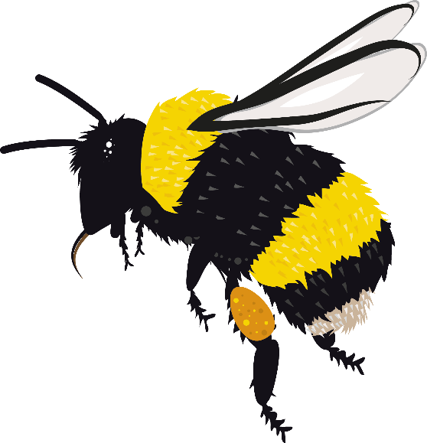
Flowers also produce a powdery substance called pollen.
Bumblebees collect pollen
in pollen baskets on
their hind legs…
…to feed to their young.
Notes:
Did you see the bumblebees' pollen baskets in the video? This is how they collect the pollen from flowers, to take to their nests and feed to their young.

Slide 6
Bumblebees rely on flowers for all their food and water. So, they must visit a lot of flowers each day.
Some bumblebees can visit up to 6,000 flowers a day!
Notes:
Ask the class to guess how many flowers a bumblebee can visit in a day, before revealing the answer.

Slide 7
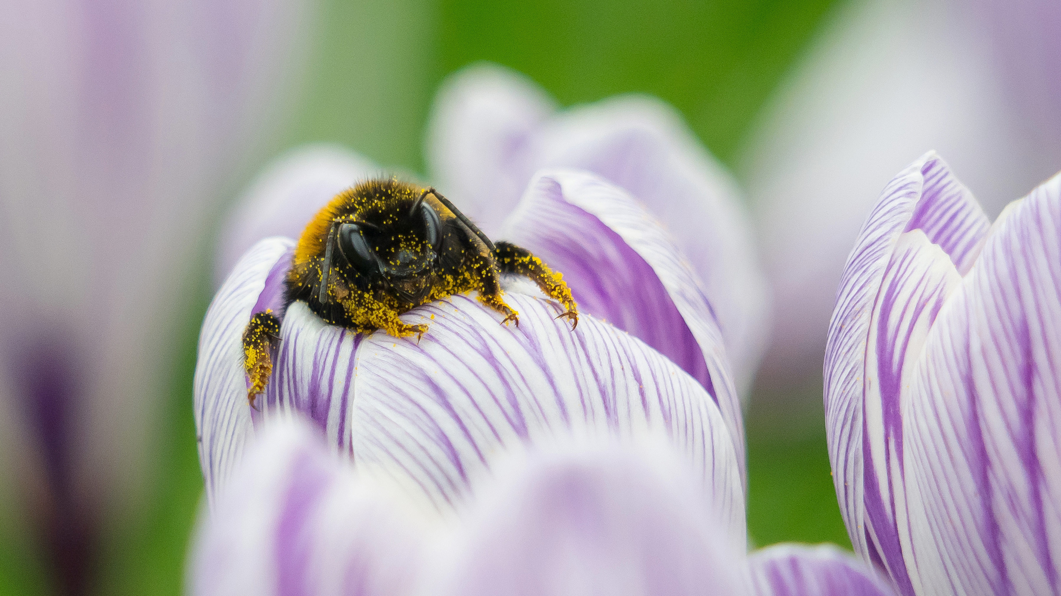
Not all of the flower’s pollen is collected in the bumblebee's pollen baskets.
Some pollen also gets attached to their hair.
Image credit: Kate Jaconello
Notes:
Bumblebees are covered in thick, fuzzy hair. This is perfect for pollen to attach itself to. While some pollen is collected for food, even more can attach to their hair.
Discussion: What happens to the pollen that is attached to the bumblebees' hair?

Slide 8
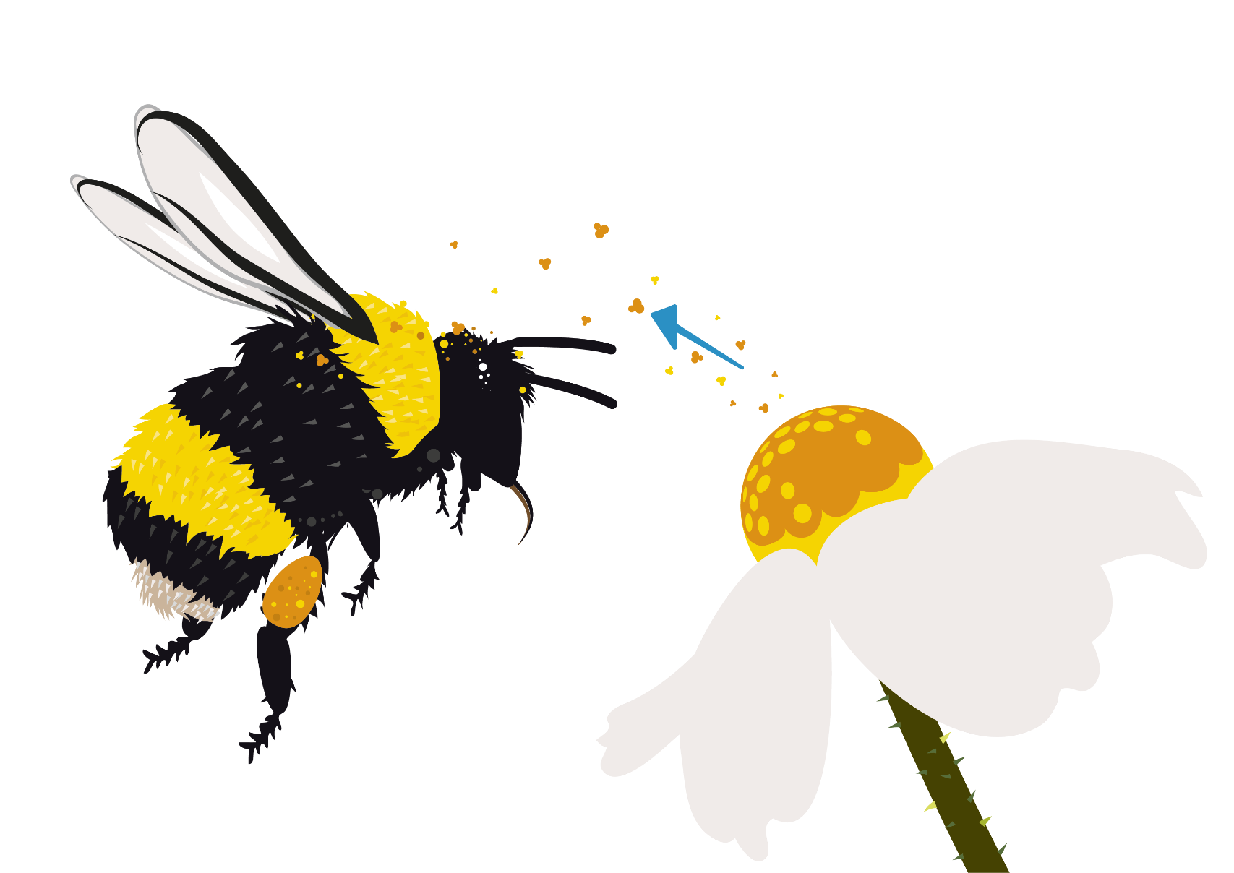
As the bumblebee travels, it moves pollen from one flower to another.
This allows the flower to make seeds.
This is pollination.
Notes:
The pollen attached to their hair will rub off onto a new flower when they visit it.
This allows the flower make seeds. This is pollination.

Slide 9
Once pollinated, the flower of a plant becomes a seed.
Some seeds are covered in juicy fruit.
Plants are unable to produce seeds unless they are pollinated.
Notes:
Discussion: Who has eaten an apple? Every apple that has ever been eaten started as a single flower on an apple tree that was visited by a pollinator that brought pollen from another apple flower. The petal fell from the flower and the base of the flower swelled up to become a delicious apple.
This is true for so many fruits and vegetables that we eat. Around 75% of the crops species that we grow require insect pollination, leading to insect pollination providing about one in every three mouthfuls of food that we eat.

Slide 10
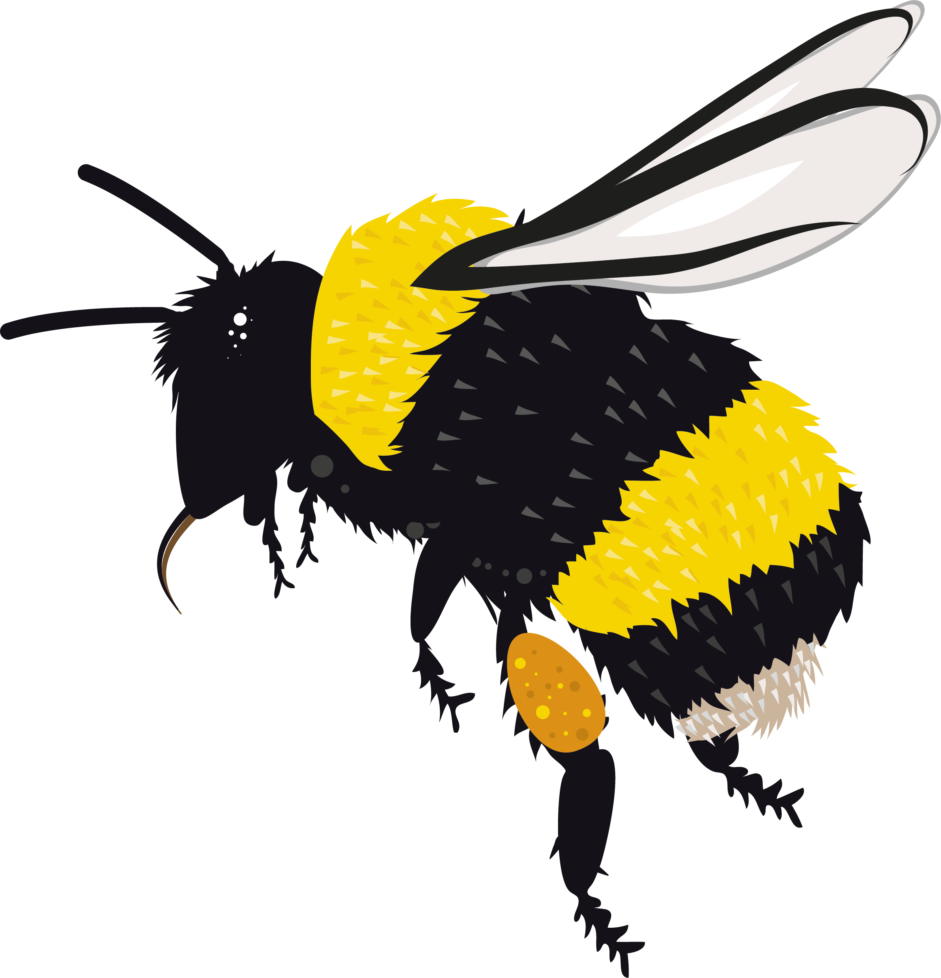
Big hairy bumblebees are amazing pollinators, but they are not the only way plants can be pollinated. How else?
Other insects such as butterflies and flies visiting plants.
Other animals such as bats.
The wind. Some plants can be pollinated by the wind carrying their pollen to other plants.
Themselves! Some plants can carry out self-pollination.

Slide 11
Play the pollination game
bumblebeeconservation.org

