Slide 1
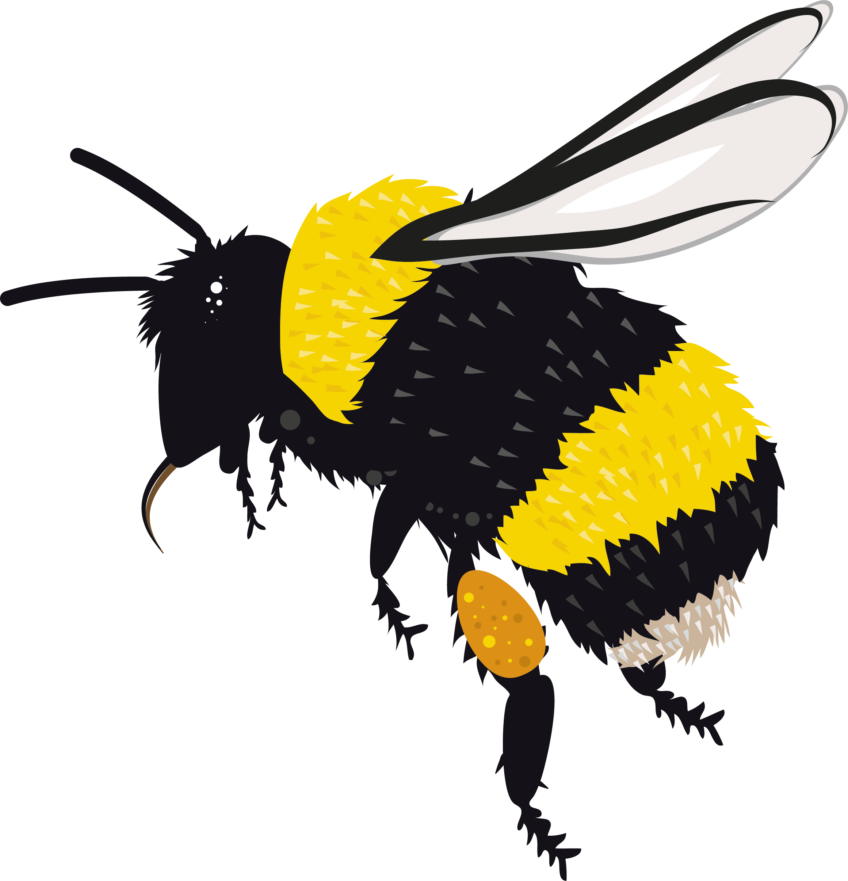
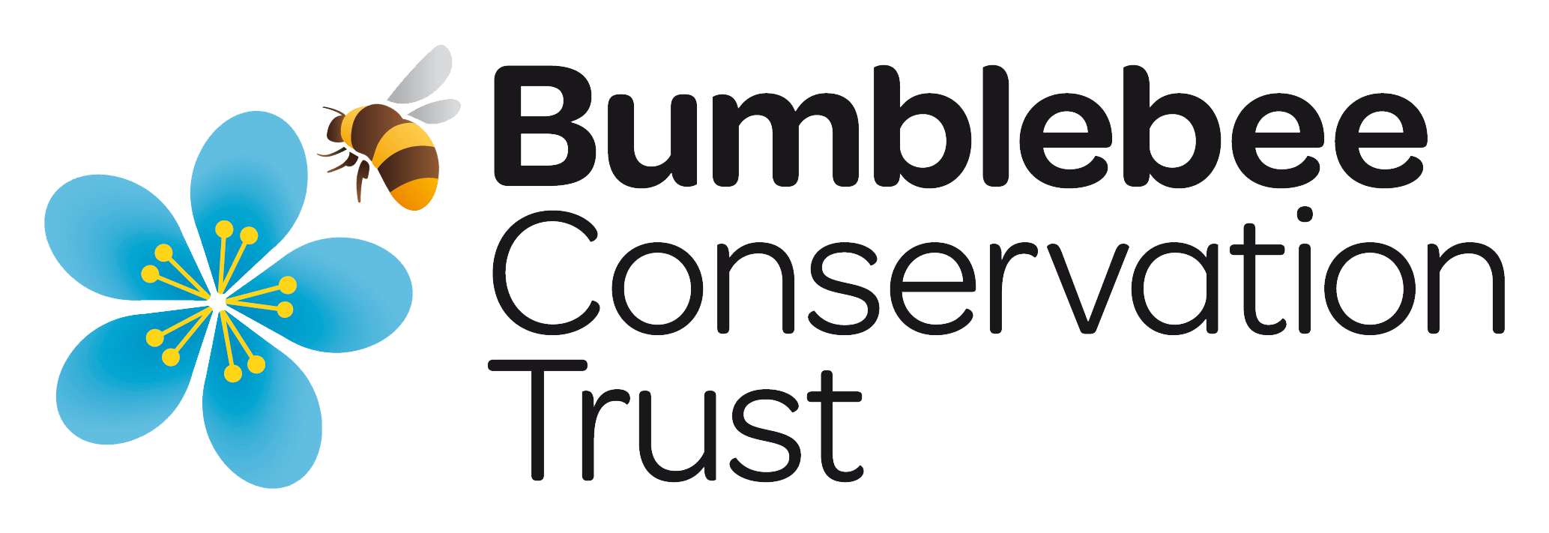
PRESENTER’S NOTE
This presentation gives an introduction to bumblebees. Please adapt the notes on each slide to supplement the information shared within the presentation, to suit your audience.
The text and images on each slide are animated and the animations will play out automatically. You will only need to transition between slides. You will know that the animation for each slide is complete and that it is time to move to the next slide when you see a bumblebee with an arrow appear at the bottom of the slide.
bumblebeeconservation.org

Slide 2
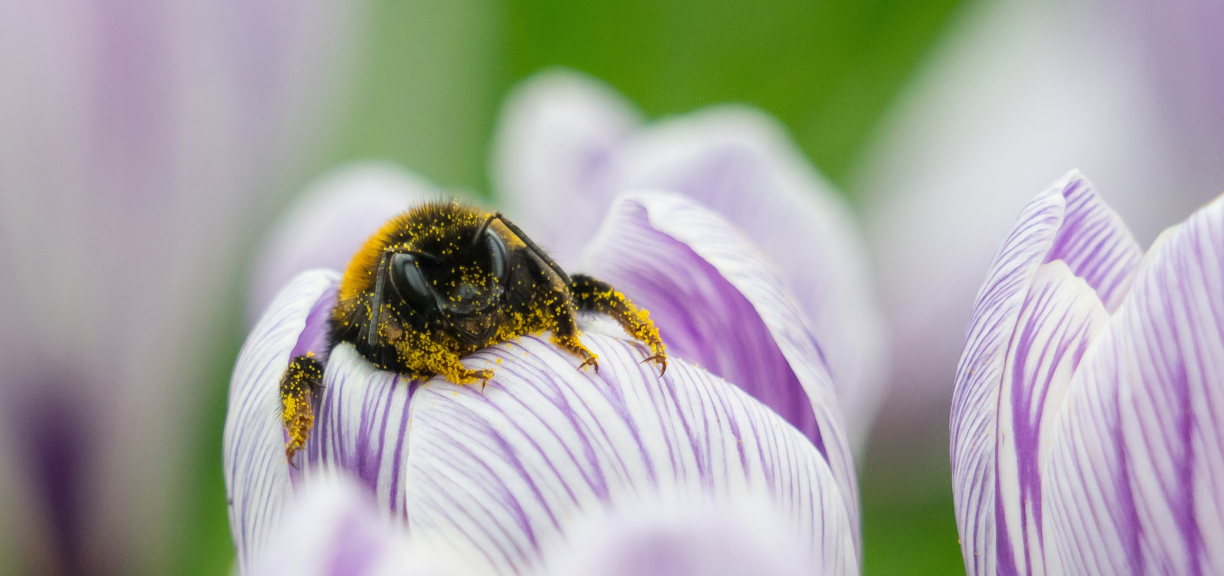
All about bumblebees
Photo: Kate Jaconello
bumblebeeconservation.org

Slide 3
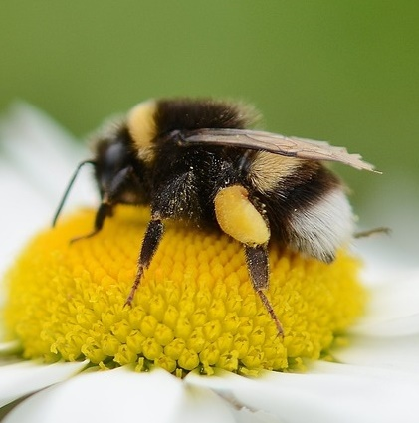
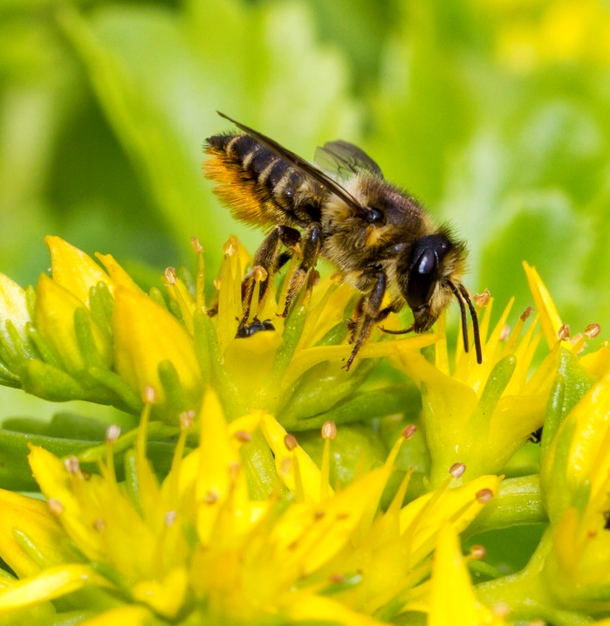
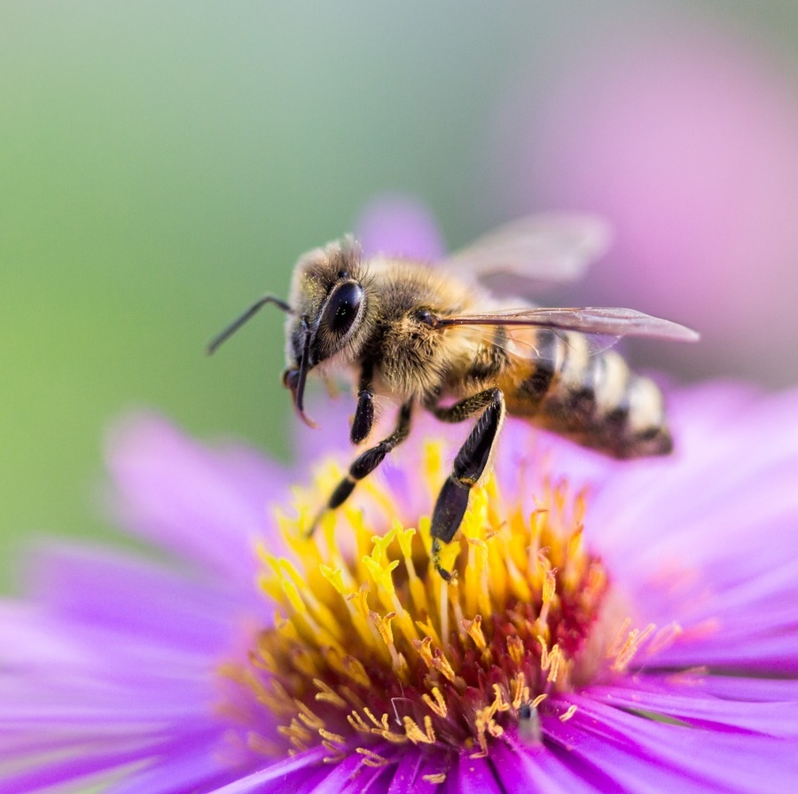
There are over 275 types of bee in the UK
24 bumblebees
1 honeybee
over 250 solitary bees
bumblebeeconservation.org
Notes:
Honeybee: 1 species of honeybee, domesticated in the UK.
The honeybee is the only UK bee species that makes honey and is managed by beekeepers. A hive can have up to 100,000 bees and is made up of one queen, female workers and male drones. Pollen is held in baskets on the back legs.
Bumblebees: 24 species of bumblebee – all of which are wild.
Most species are social and live in nests of 50–400 bees. A social nest creates queens, female workers and males. Bumblebees often like to nest where small mammals or birds have nested before. Pollen is held in baskets on the back legs.
Solitary bees: 250 solitary bee species – all of which are wild.
Solitary bees do not have social colonies with workers. Each female tends to her own young, although they are called solitary bees, some can be found living in large groups. Bee hotels, bare ground and banks can be used for nesting by solitary bees. Pollen is held in dense hairs, either on the back legs or under the abdomen, depending on the species.

Slide 4
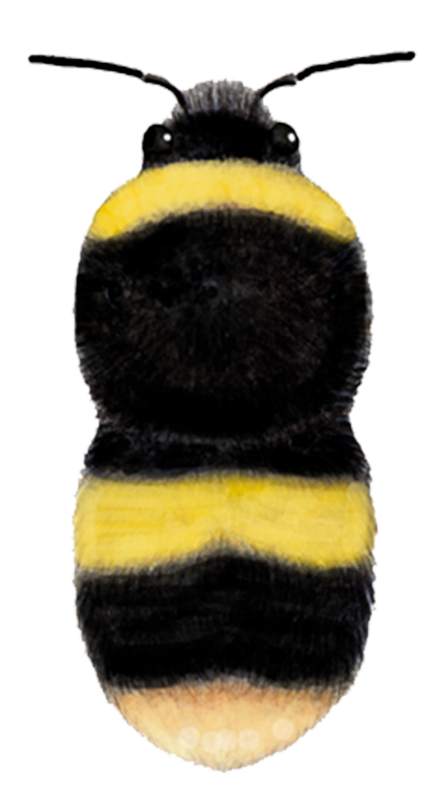
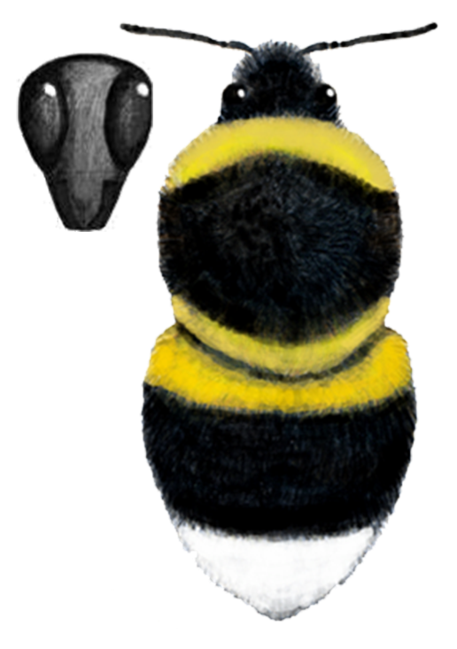
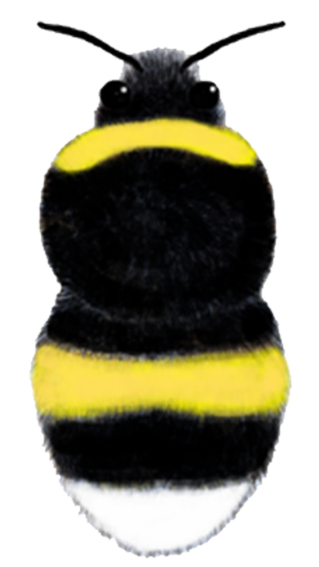
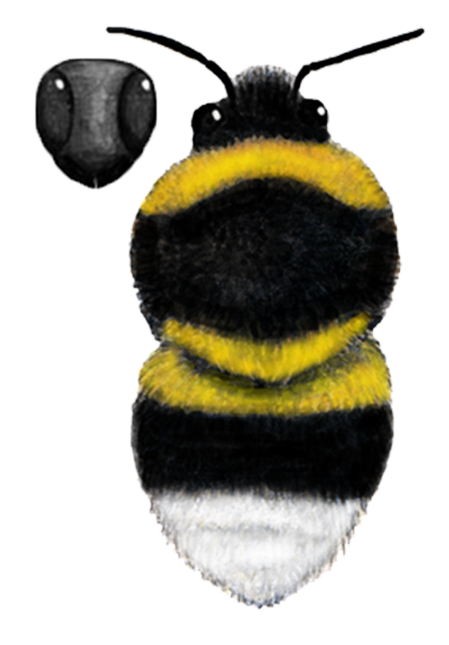
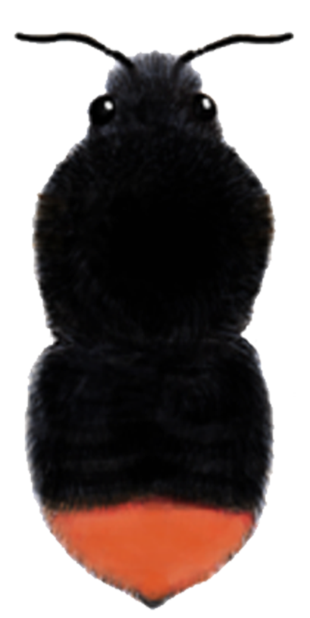
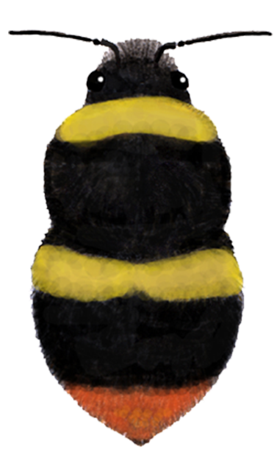
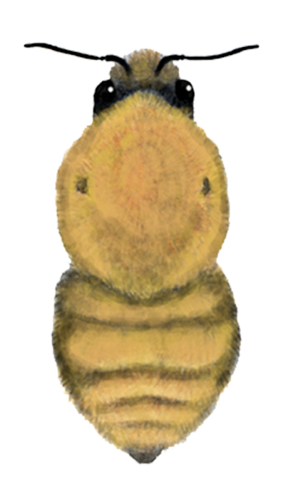
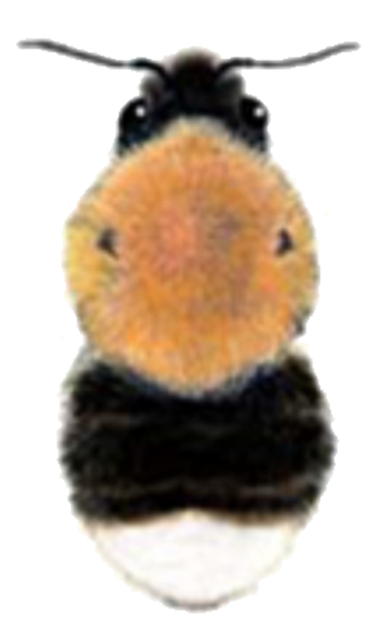
8 of our 24 bumblebees are common and widespread
Buff-tailed bumblebee
White-tailed bumblebee
Garden bumblebee
Heath bumblebee
Red-tailed bumblebee
Early bumblebee
Common carder bumblebee
Tree bumblebee
bumblebeeconservation.org
Notes:
There are 24 species of bumblebee currently resident in Britain. 8 of these species are widespread across most of Britain and are known as the ‘Big 8’.
How to identify a bumblebee
1. What does a bumblebee look like?
Bumblebees are hairy insects with an audible buzz and a characteristic bumbling flight. Their bodies have three sections: the head, the thorax and the abdomen. The queens can be very large, while workers and males can vary in size. Be aware that there are some other insects that mimic bumblebees, like hoverflies, however these insects hover and dart and have large fly-like eyes.
2. What colour is the tail?
Bumblebees fall into three rough groups based on tail colour: white-tailed (includes off-white to beige), red-tailed, and ‘uniform-tailed’ bees, where the tail is the same colour as the rest of the abdomen (usually ginger).
3. How many colour bands does it have?
Not including black hair or the tail colour, how many bands or solid colours do you see on the thorax and the abdomen? Adding this information with the tail colour and comparing with the eight bees detailed in this app should be enough to work out which common bumblebee species you have seen.

Slide 5
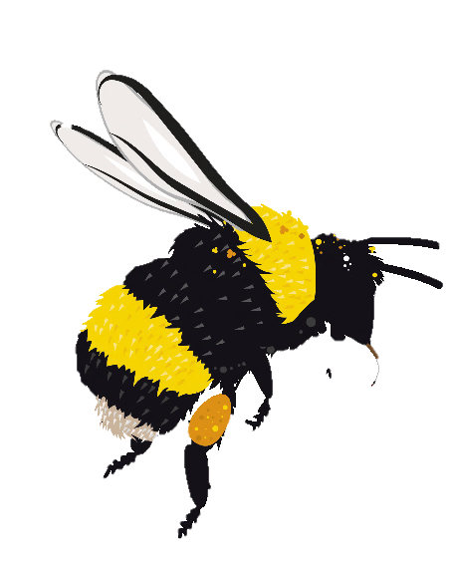
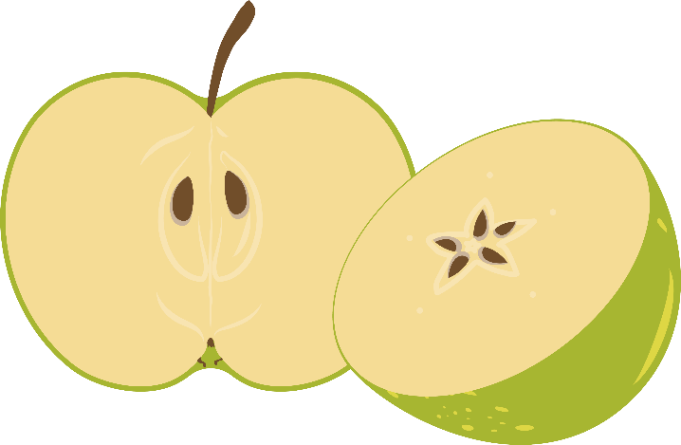
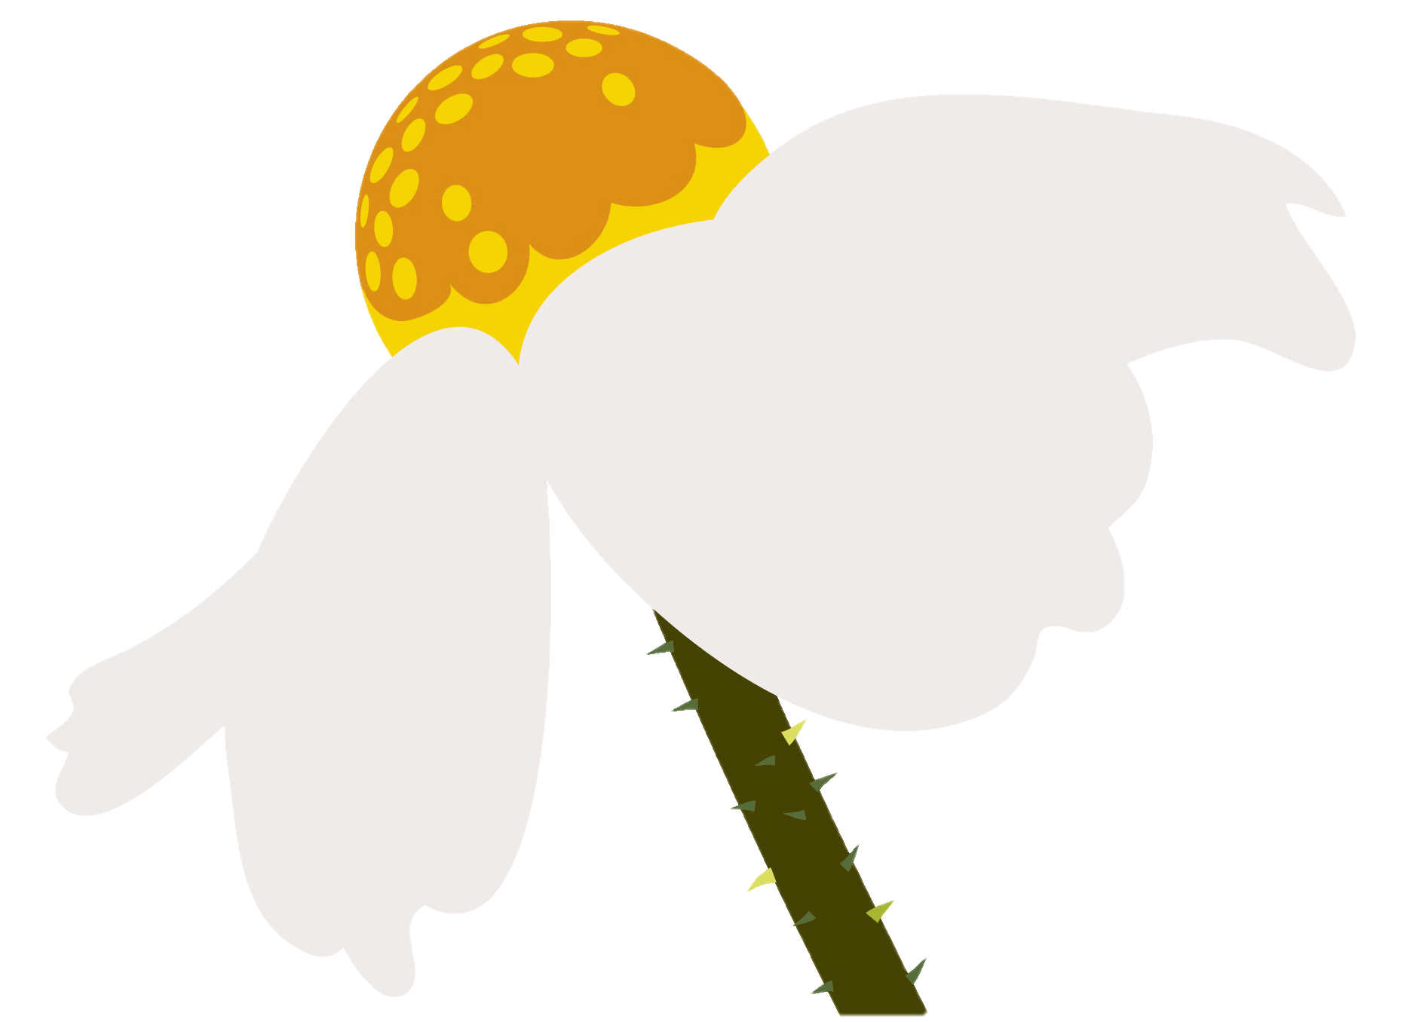
All bees are pollinators….
but bumblebees are really amazing at it!
pollination is the movement of pollen from one flower to another
pollination allows plants to produce seeds and fruits
bumblebeeconservation.org
Notes:
What is pollination?
Pollination occurs when pollen from a flower’s anther is transferred to the stigma of another flower of the same type. When this happens, the pollen sends a pollen tube down to the ovary and into an ovule. When this happens fertilisation occurs and a seed is created.
Why are bumblebees important in pollination?
Bumblebees visit flowers to collect pollen, for their larvae, and nectar. When the bumblebees collect the pollen, some of it sticks to their hairs. When the bumblebee lands on the next flower some of the pollen can fall off. Bumblebees often show preferences when feeding and visit lots of flowers of the same type.
Why do we need bumblebees to produce some of the food that we eat?
When fertilisation happens, a seed is formed in a flower’s ovary. That ovary then swells and becomes the flesh of a fruit. Many of these fruits, such as apples, are eaten by people. Bumblebees are important in this process because they transport pollen from one flower to another to allow fertilisation to take place.

Slide 6
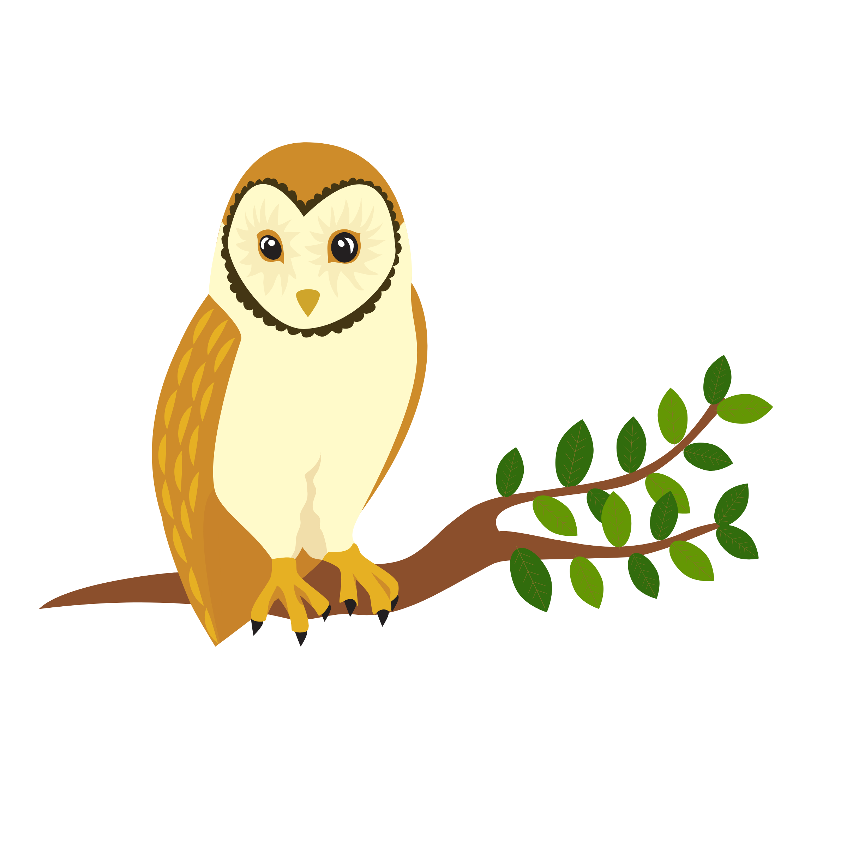
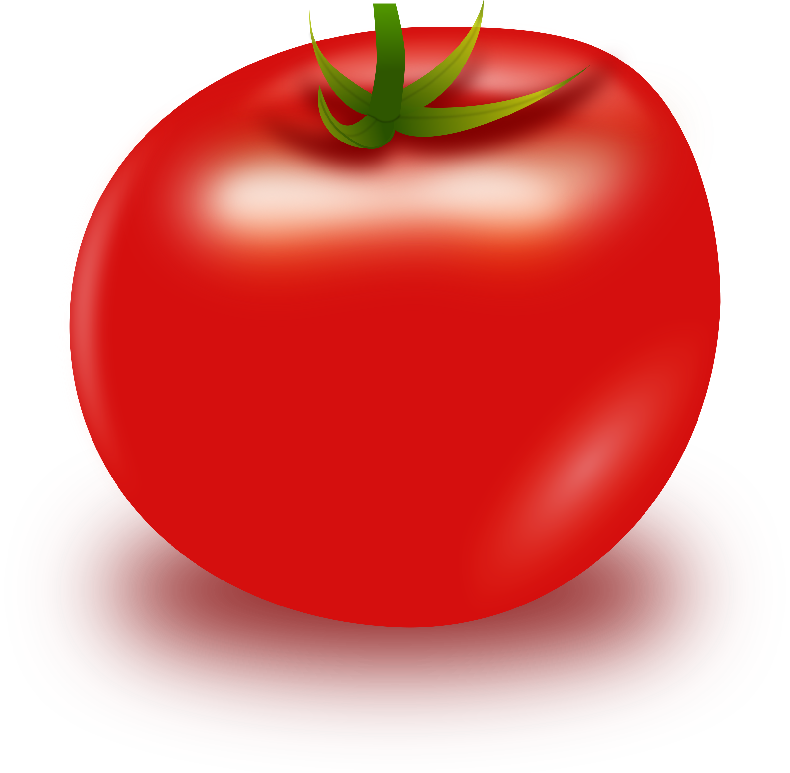
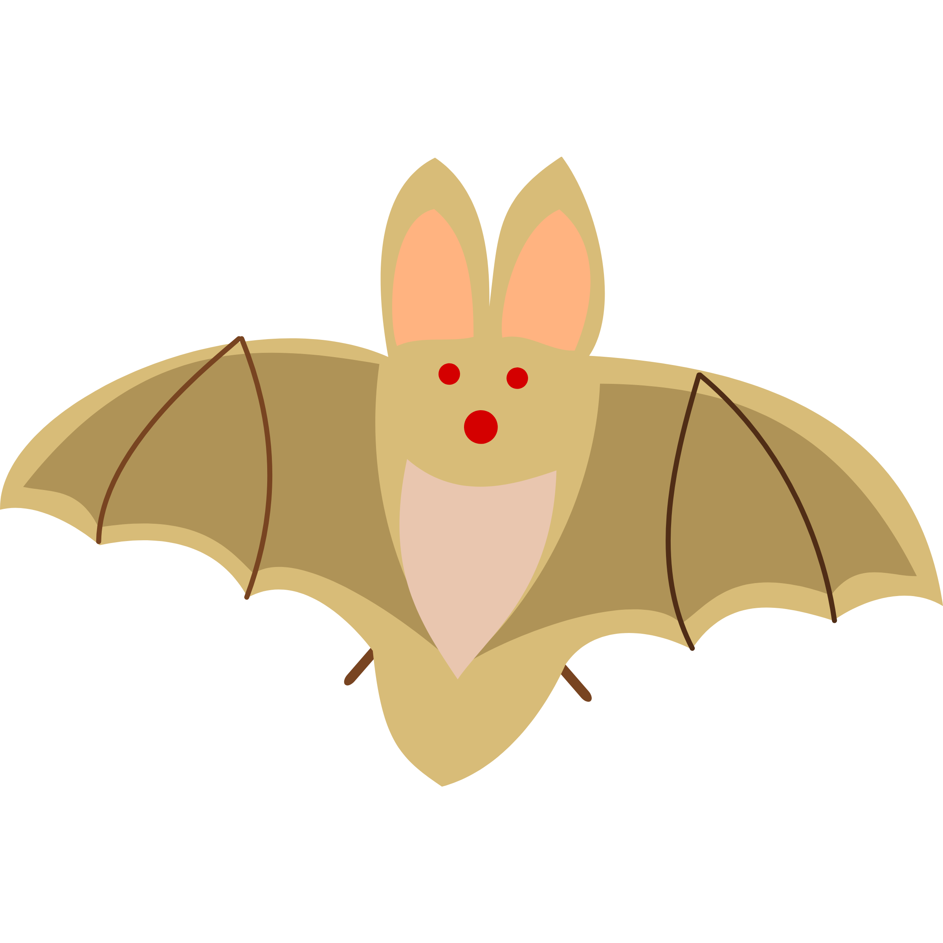
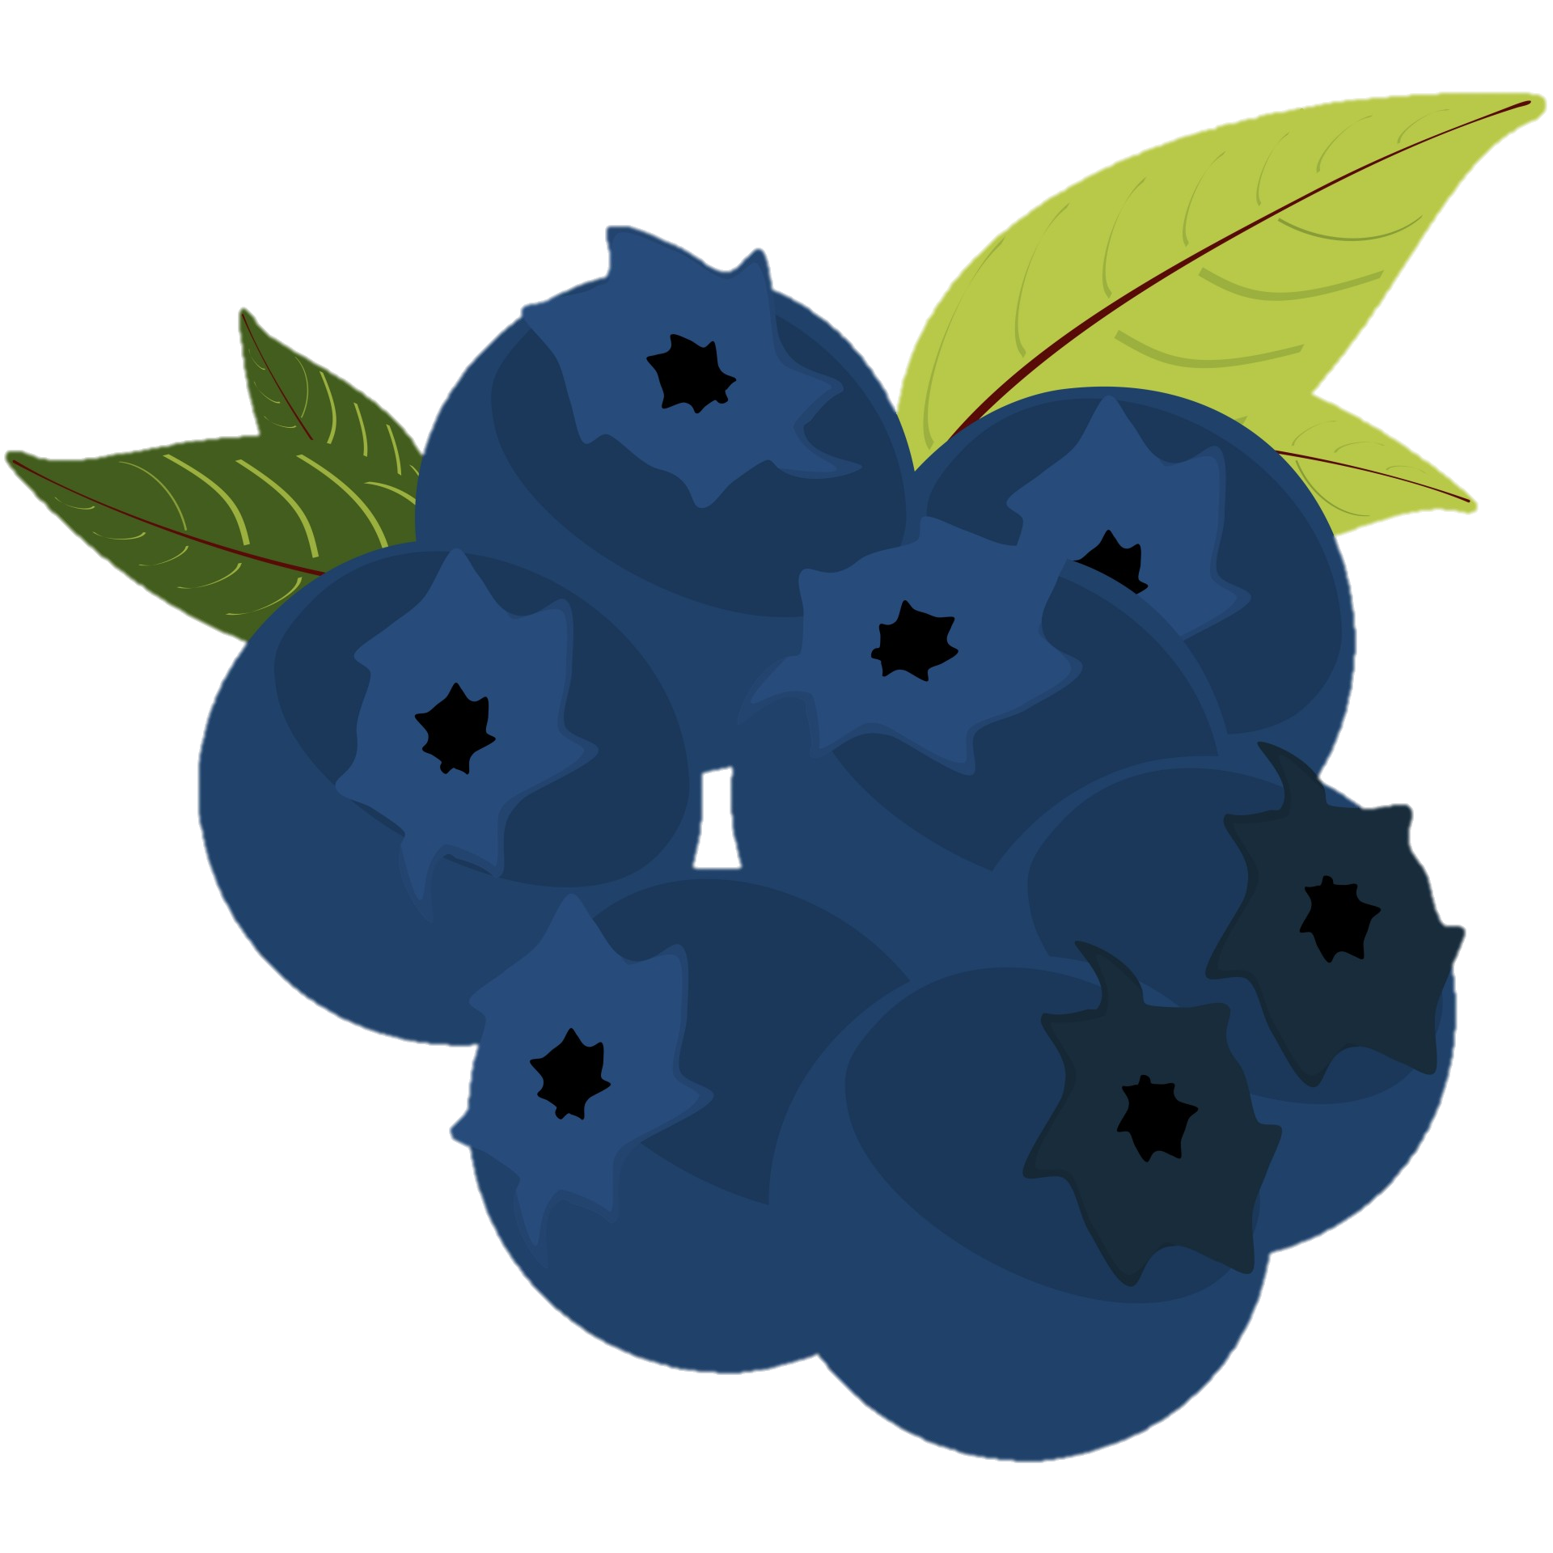
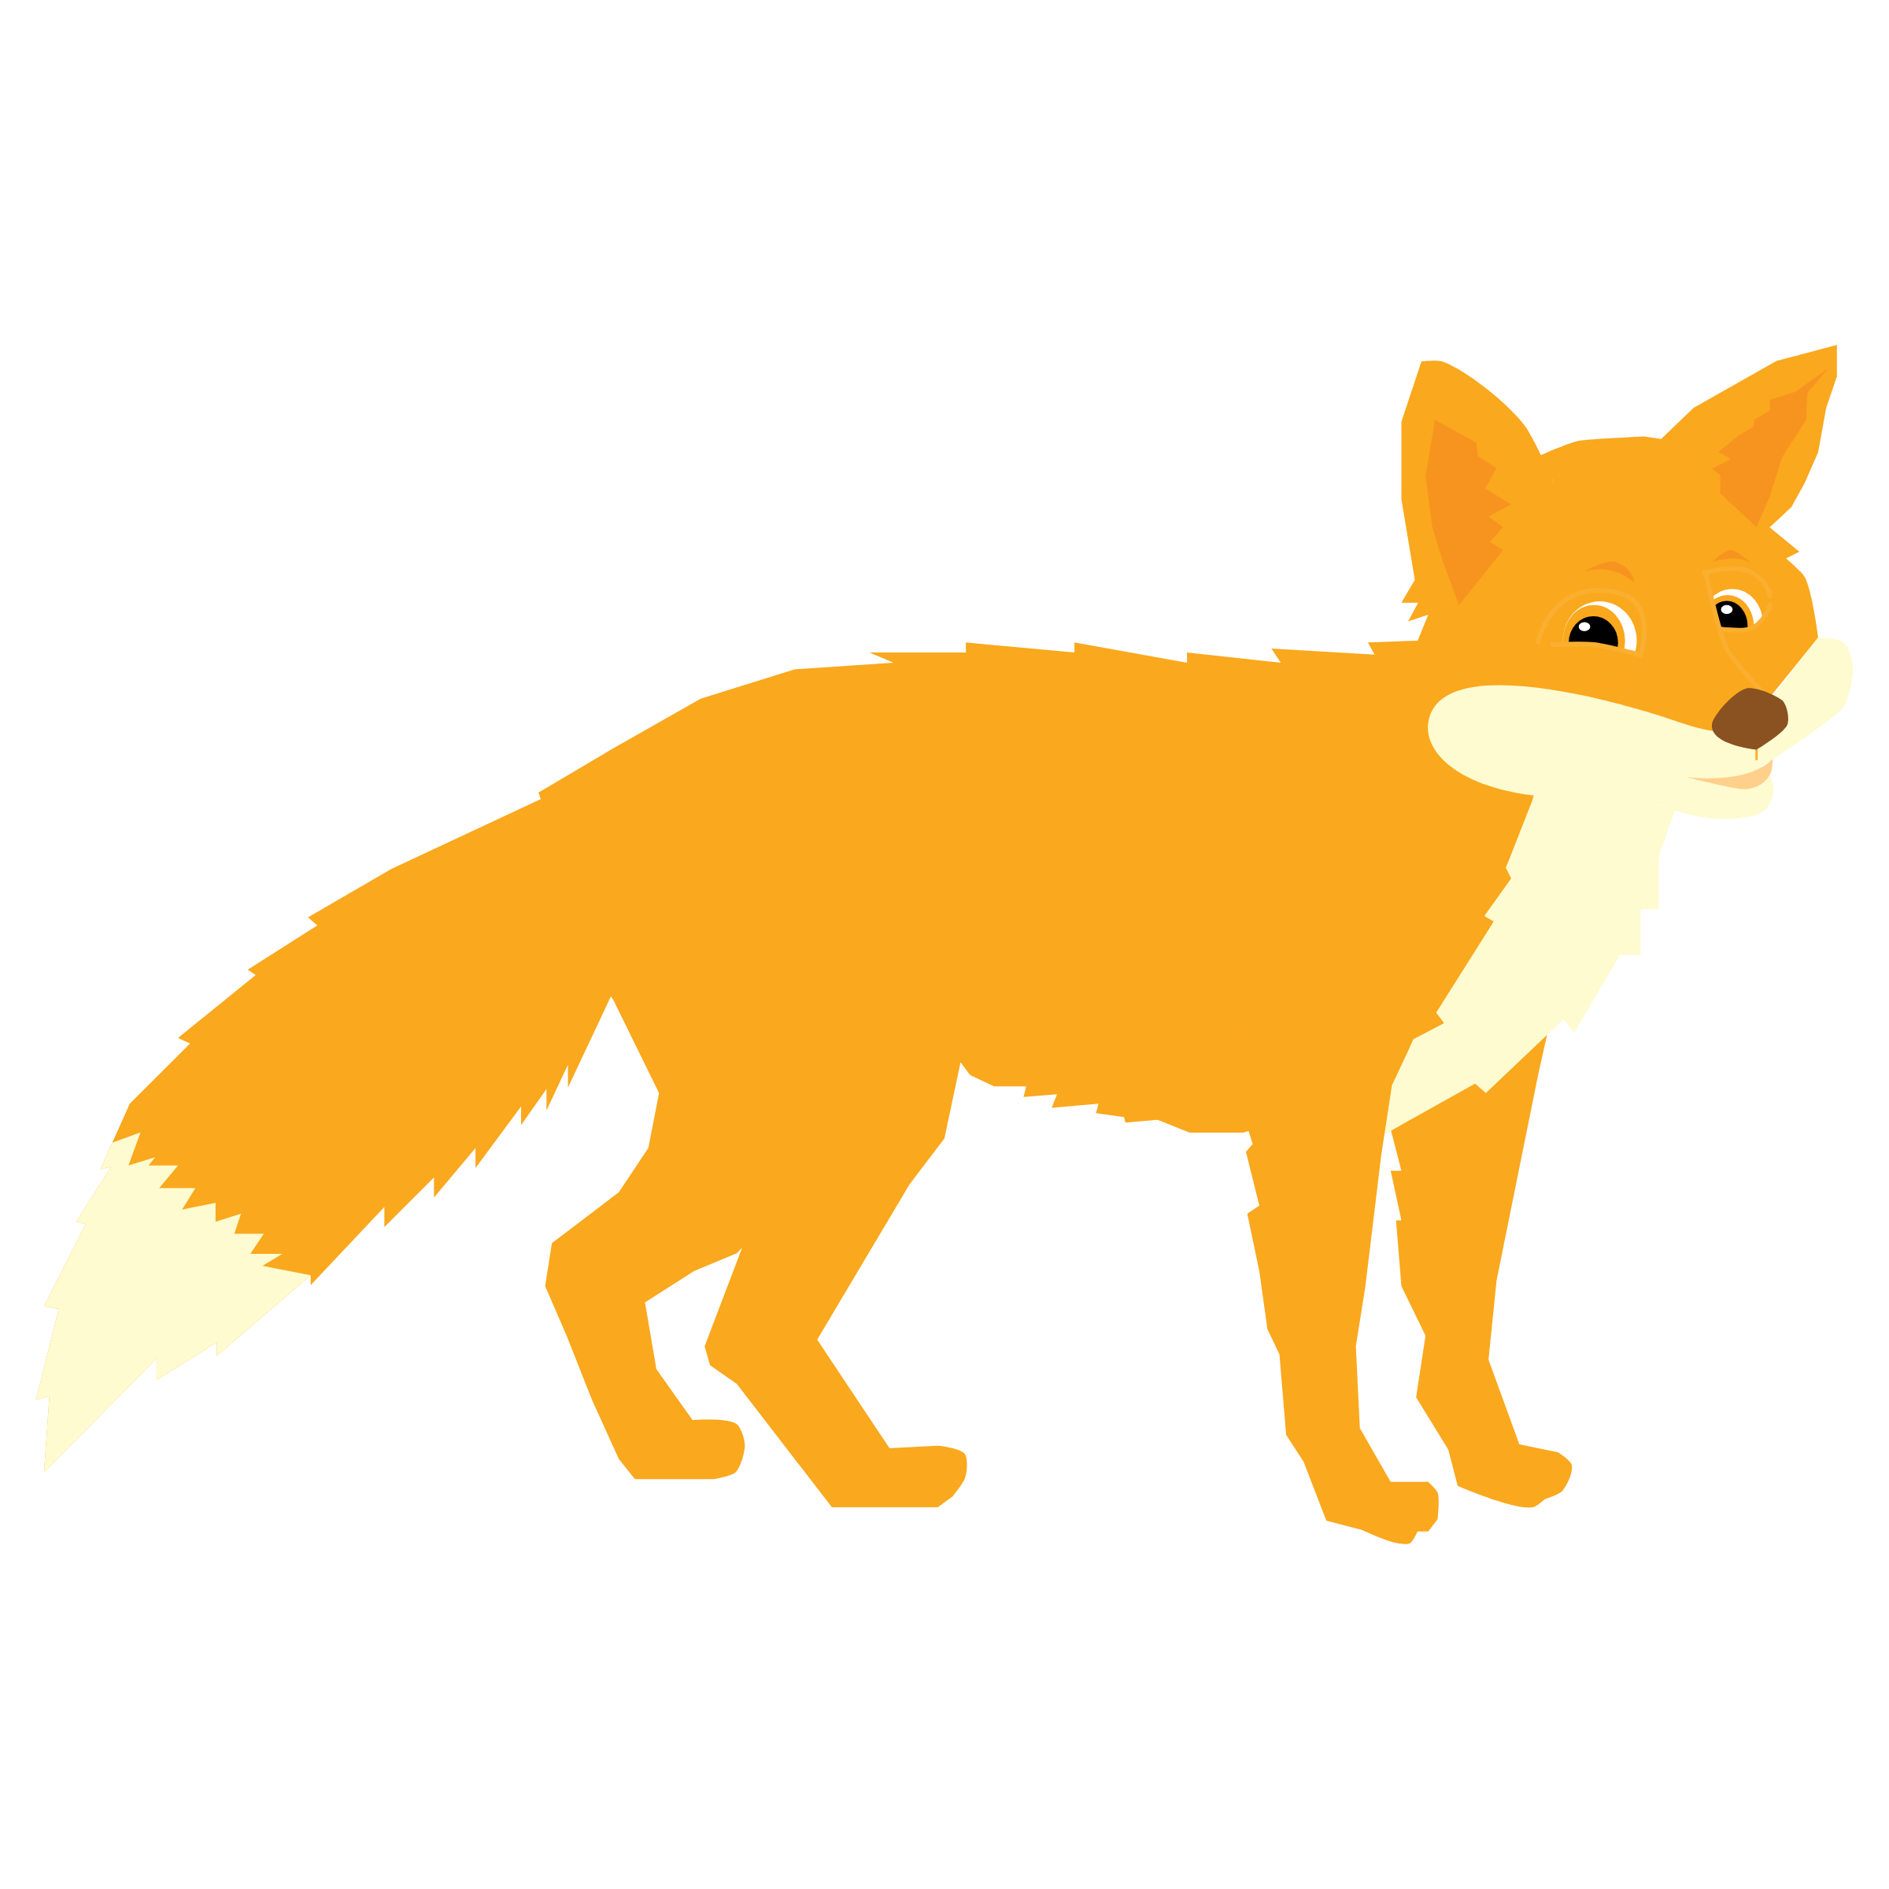
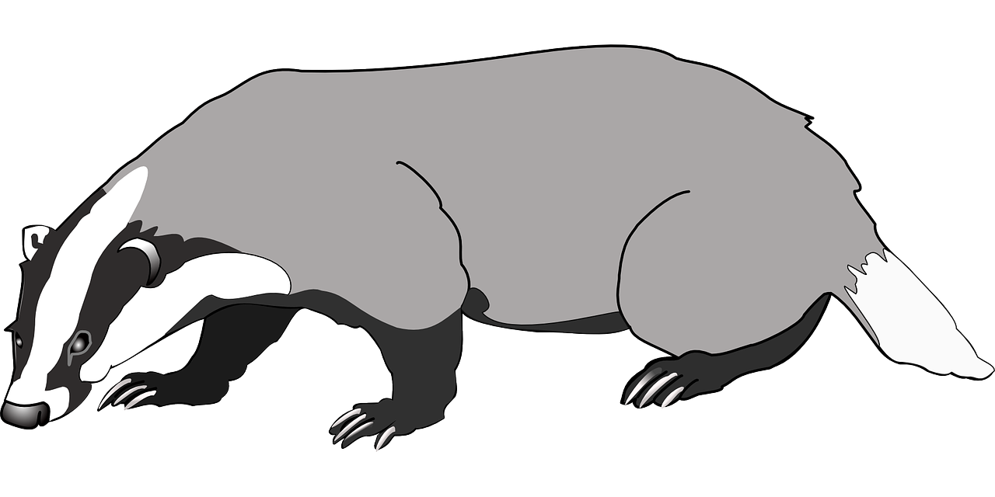
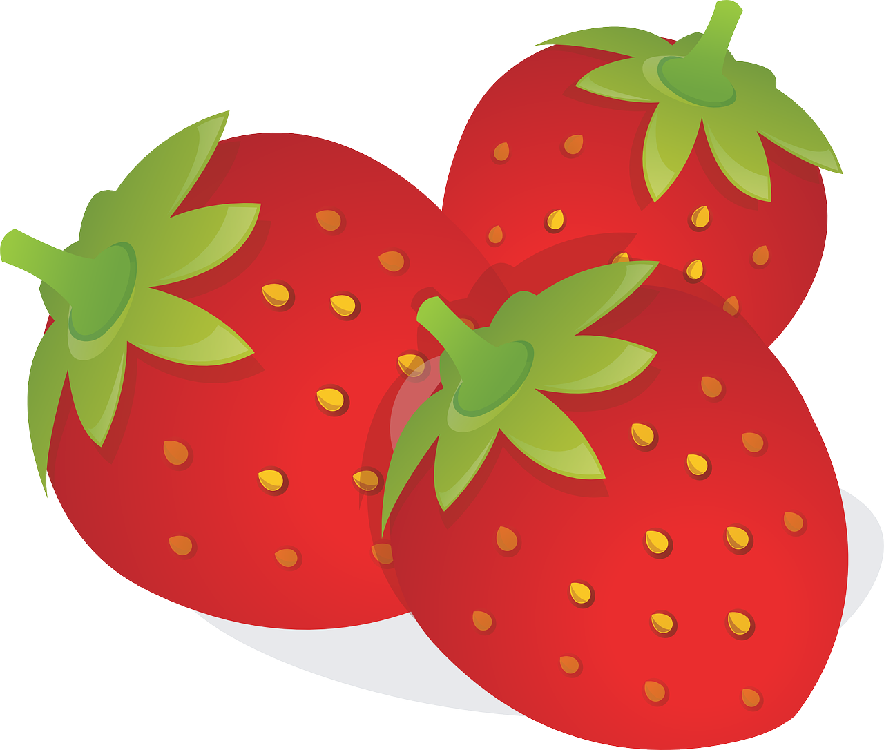
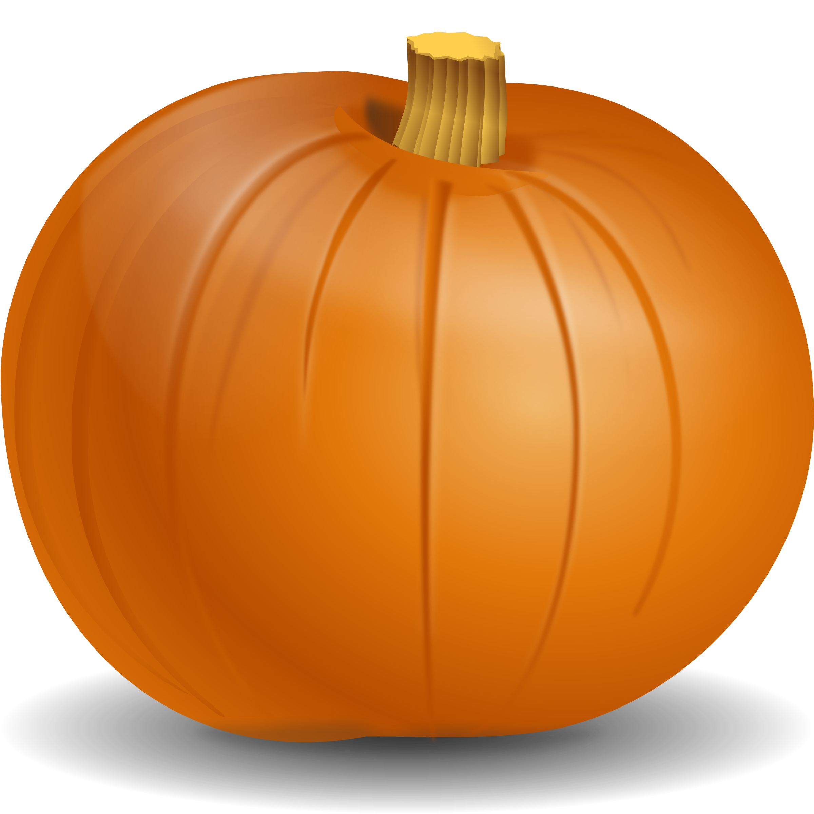
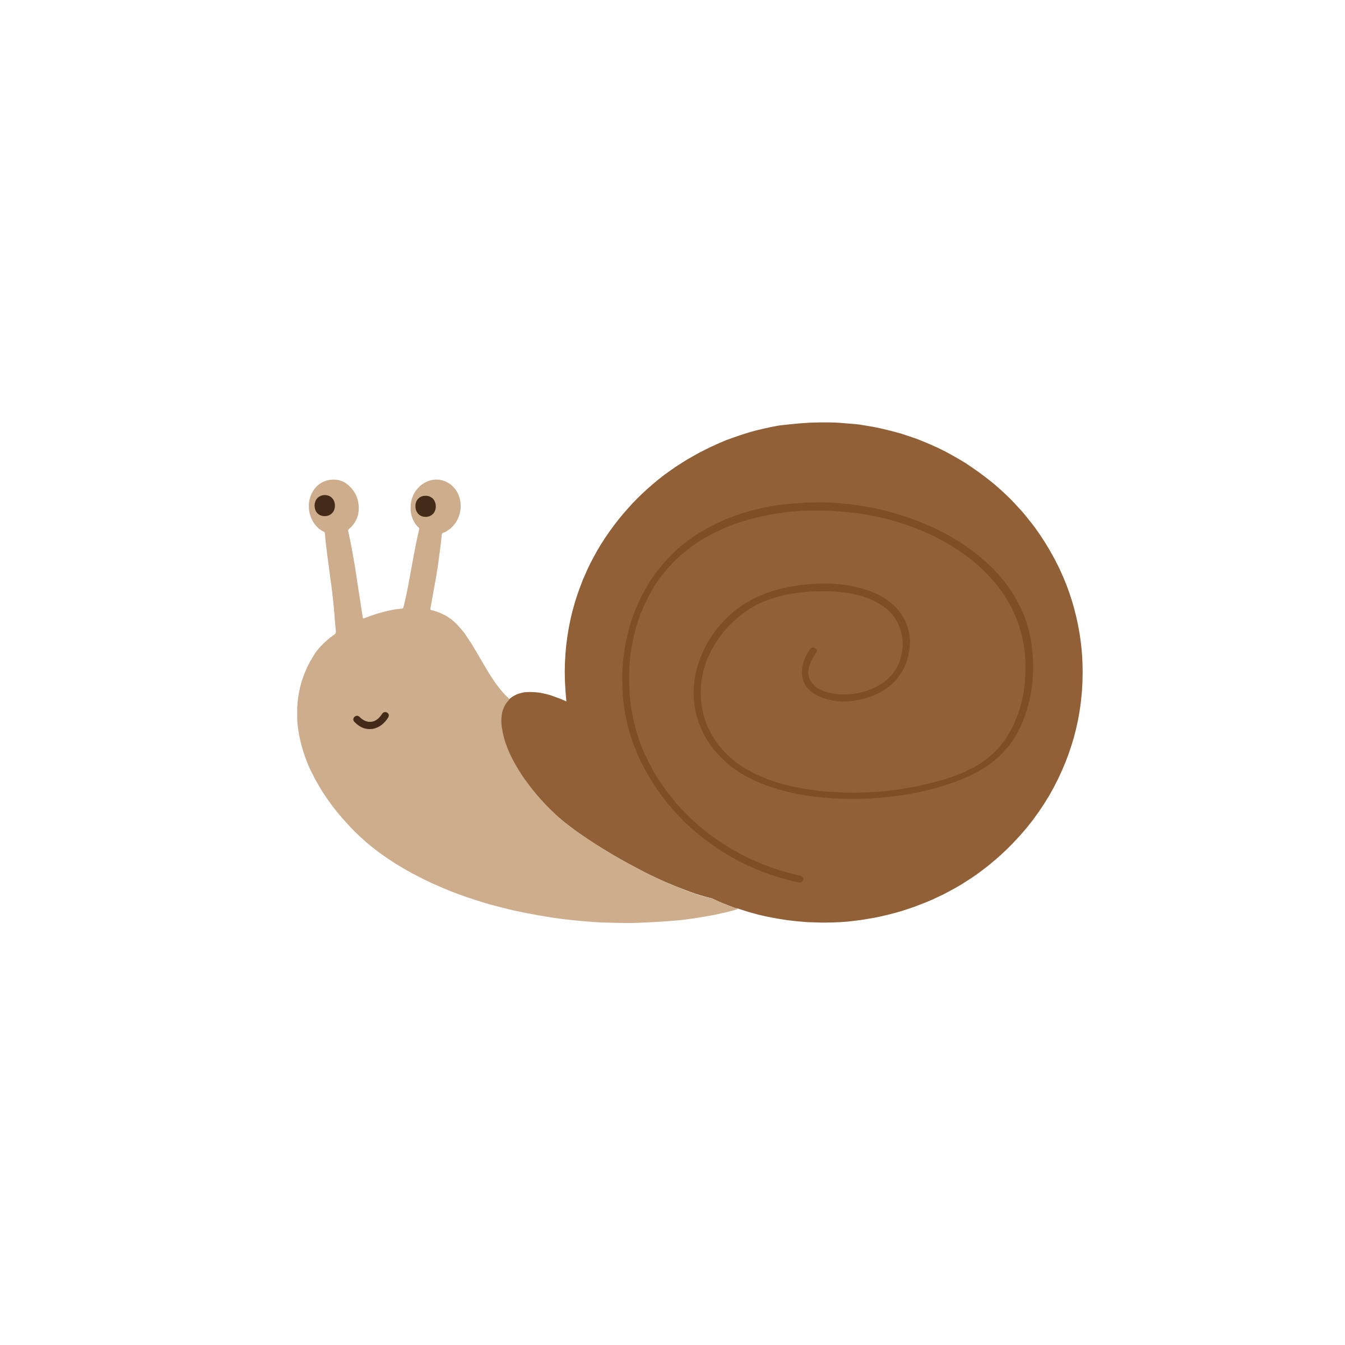
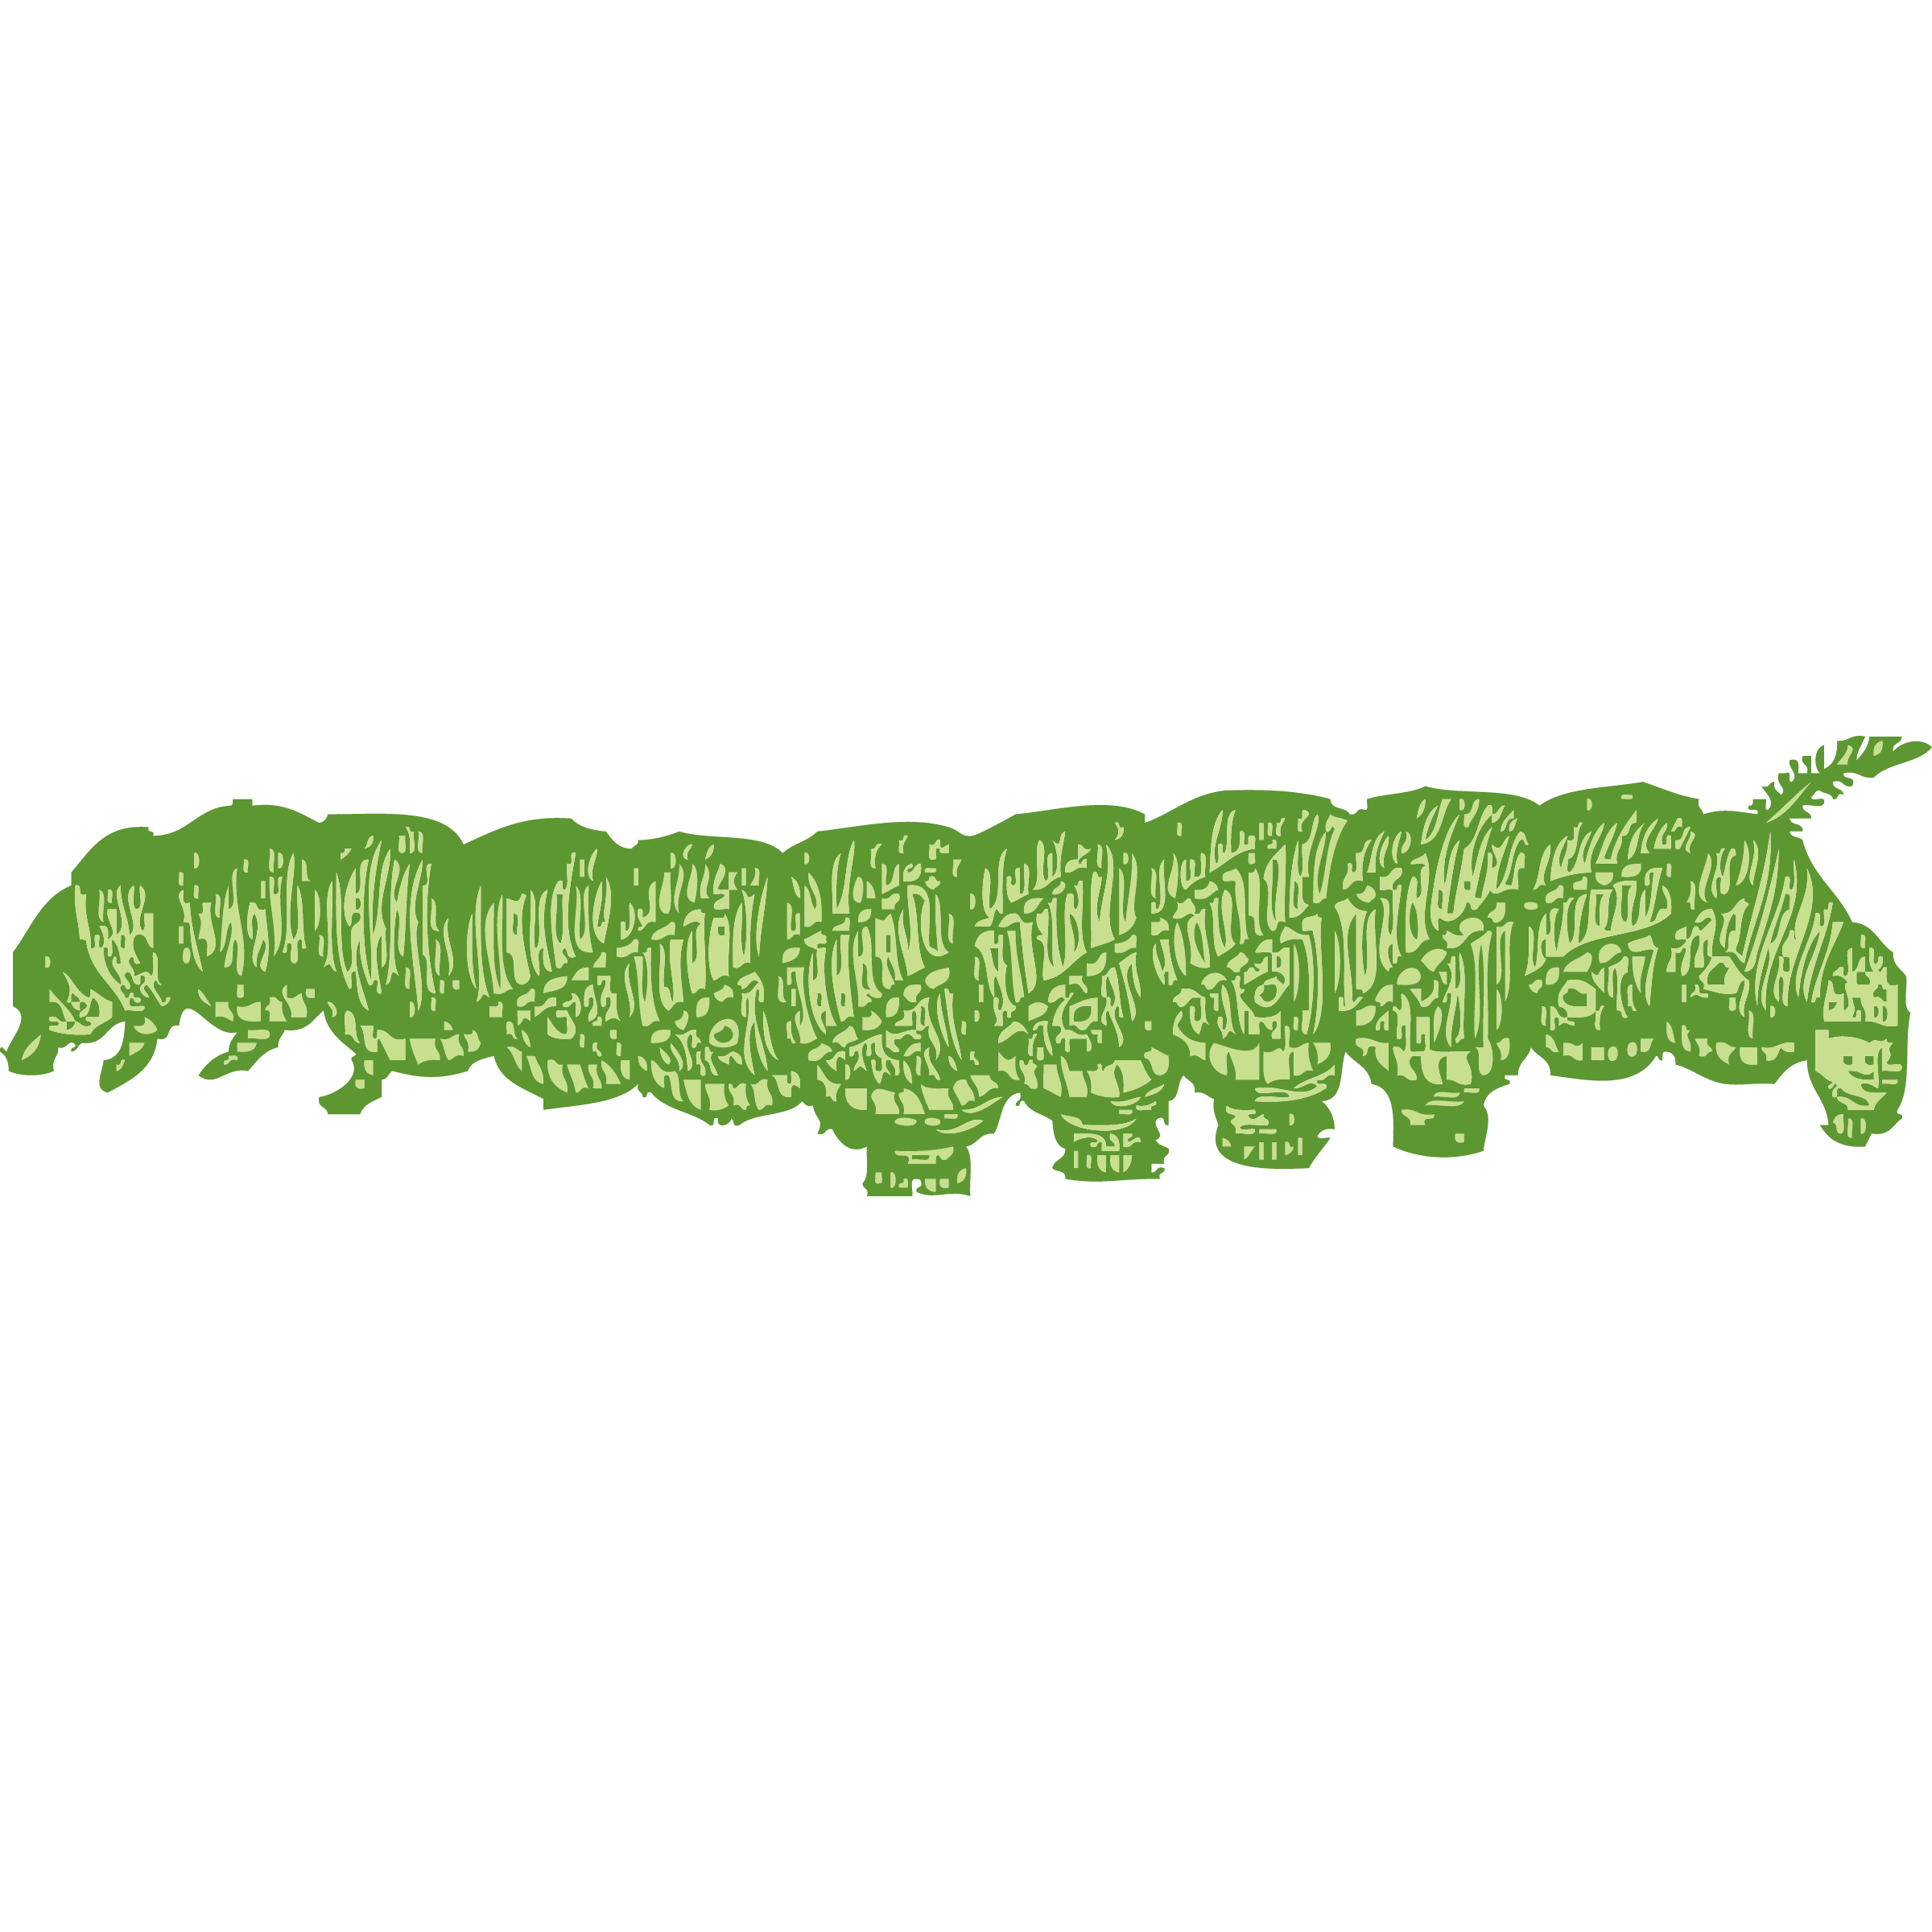
through pollination, bumblebees help…
plants to make more plants
provide us with nutritious and delicious fruits and vegetables
support whole food webs
bumblebeeconservation.org
Notes:
It is well-known that bumblebees are great pollinators, and therefore have a key role in producing much of the food that we eat. Through the pollination of many commercial crops such as tomatoes, peas, apples and strawberries, insects are estimated to contribute over £600 million per annum to the UK economy (2015), and in doing so prop up the £108 billion per-year food and drink industry in Britain. Across the EU, insect pollinators are estimated to contribute €14.2 billion annually to the EU economy (2012). If bumblebee and other insect pollinator declines continue, the extremely high cost of pollinating these plants by other means could significantly increase the cost of fruit and vegetables (hand-pollinating British crops has been estimated to cost £1.8 billion annually).
Bumblebees also help pollinate many wildflowers, allowing them to reproduce. Without this pollination many of these plants would not produce seeds, resulting in declines in both abundance and distribution for a range of species. As these plants are often the basis of complex food chains, it is easy to imagine how other wildlife such as other insects, birds and mammals would all suffer if bees disappeared.
Bumblebees and other pollinators also play a vital role in our own health and wellbeing. By ensuring the diversity and abundance of fruits and vegetables, bumblebees ensure that we have access to a healthy and nutritious diet. Furthermore, through the service of pollination they also underpin the wider ecosystems and natural landscapes that can have such positive impacts on our wellbeing

Slide 7
Bumblebees help to feed us….
bumblebees can only get their food from flowers
but they are going hungry!
In the last century
97%
of the UKs wildflower meadows have been lost
bumblebeeconservation.org
Notes:
Why do bumblebees need our help?
Bumblebees only feed on flowers. Each colony of bumblebees needs to have access to enough flowers to sustain 40-400 workers, throughout the lifespan of the nest (potentially several months March-October) in order to allow the queen to produce new males and queens at the end of the colony lifecycle.
Habitat loss has been the main driver of bumblebee decline. With the loss of over 97% of Britain’s flower-rich meadows, in the last century, it is no surprise that bumblebees have been put under enormous pressure. There have been many factors that have led to the loss of flower-rich meadows, including urban expansion, herbicide and pesticide use, and agricultural intensification.
Bumblebees also face an increasing threat from climate change. As a species that has adapted to survive in cooler climates, many bumblebees will be squeezed northwards as the climate continues to warm. This could cause a particular problem for some of our rarest bumblebees, including the Great Yellow bumblebee, which is already clinging to survival in isolated pockets along Britain’s most northerly coastline and islands. Summer droughts, intensifying winter storm, and shifts in seasonal patterns, such as early springs, will also cause huge problems for bumblebees.

Slide 8
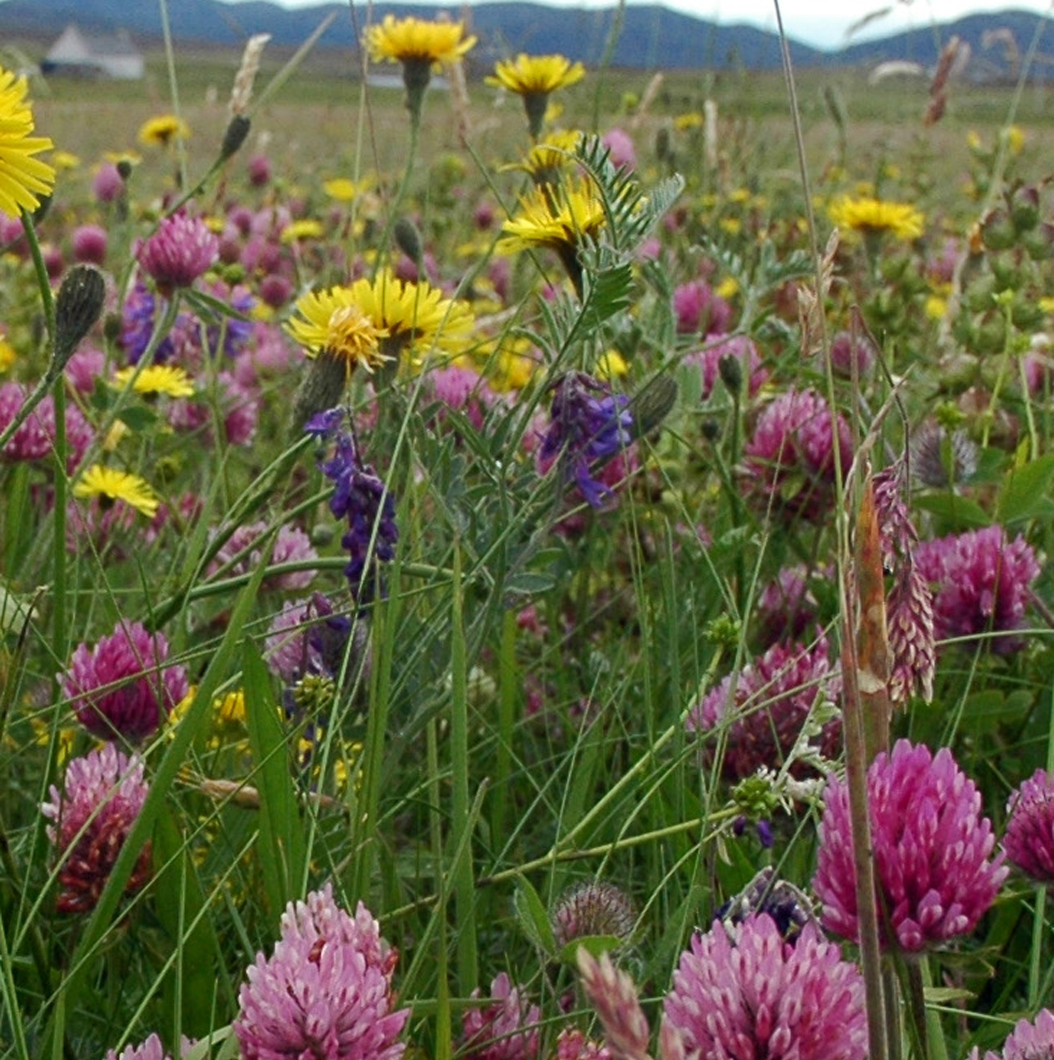
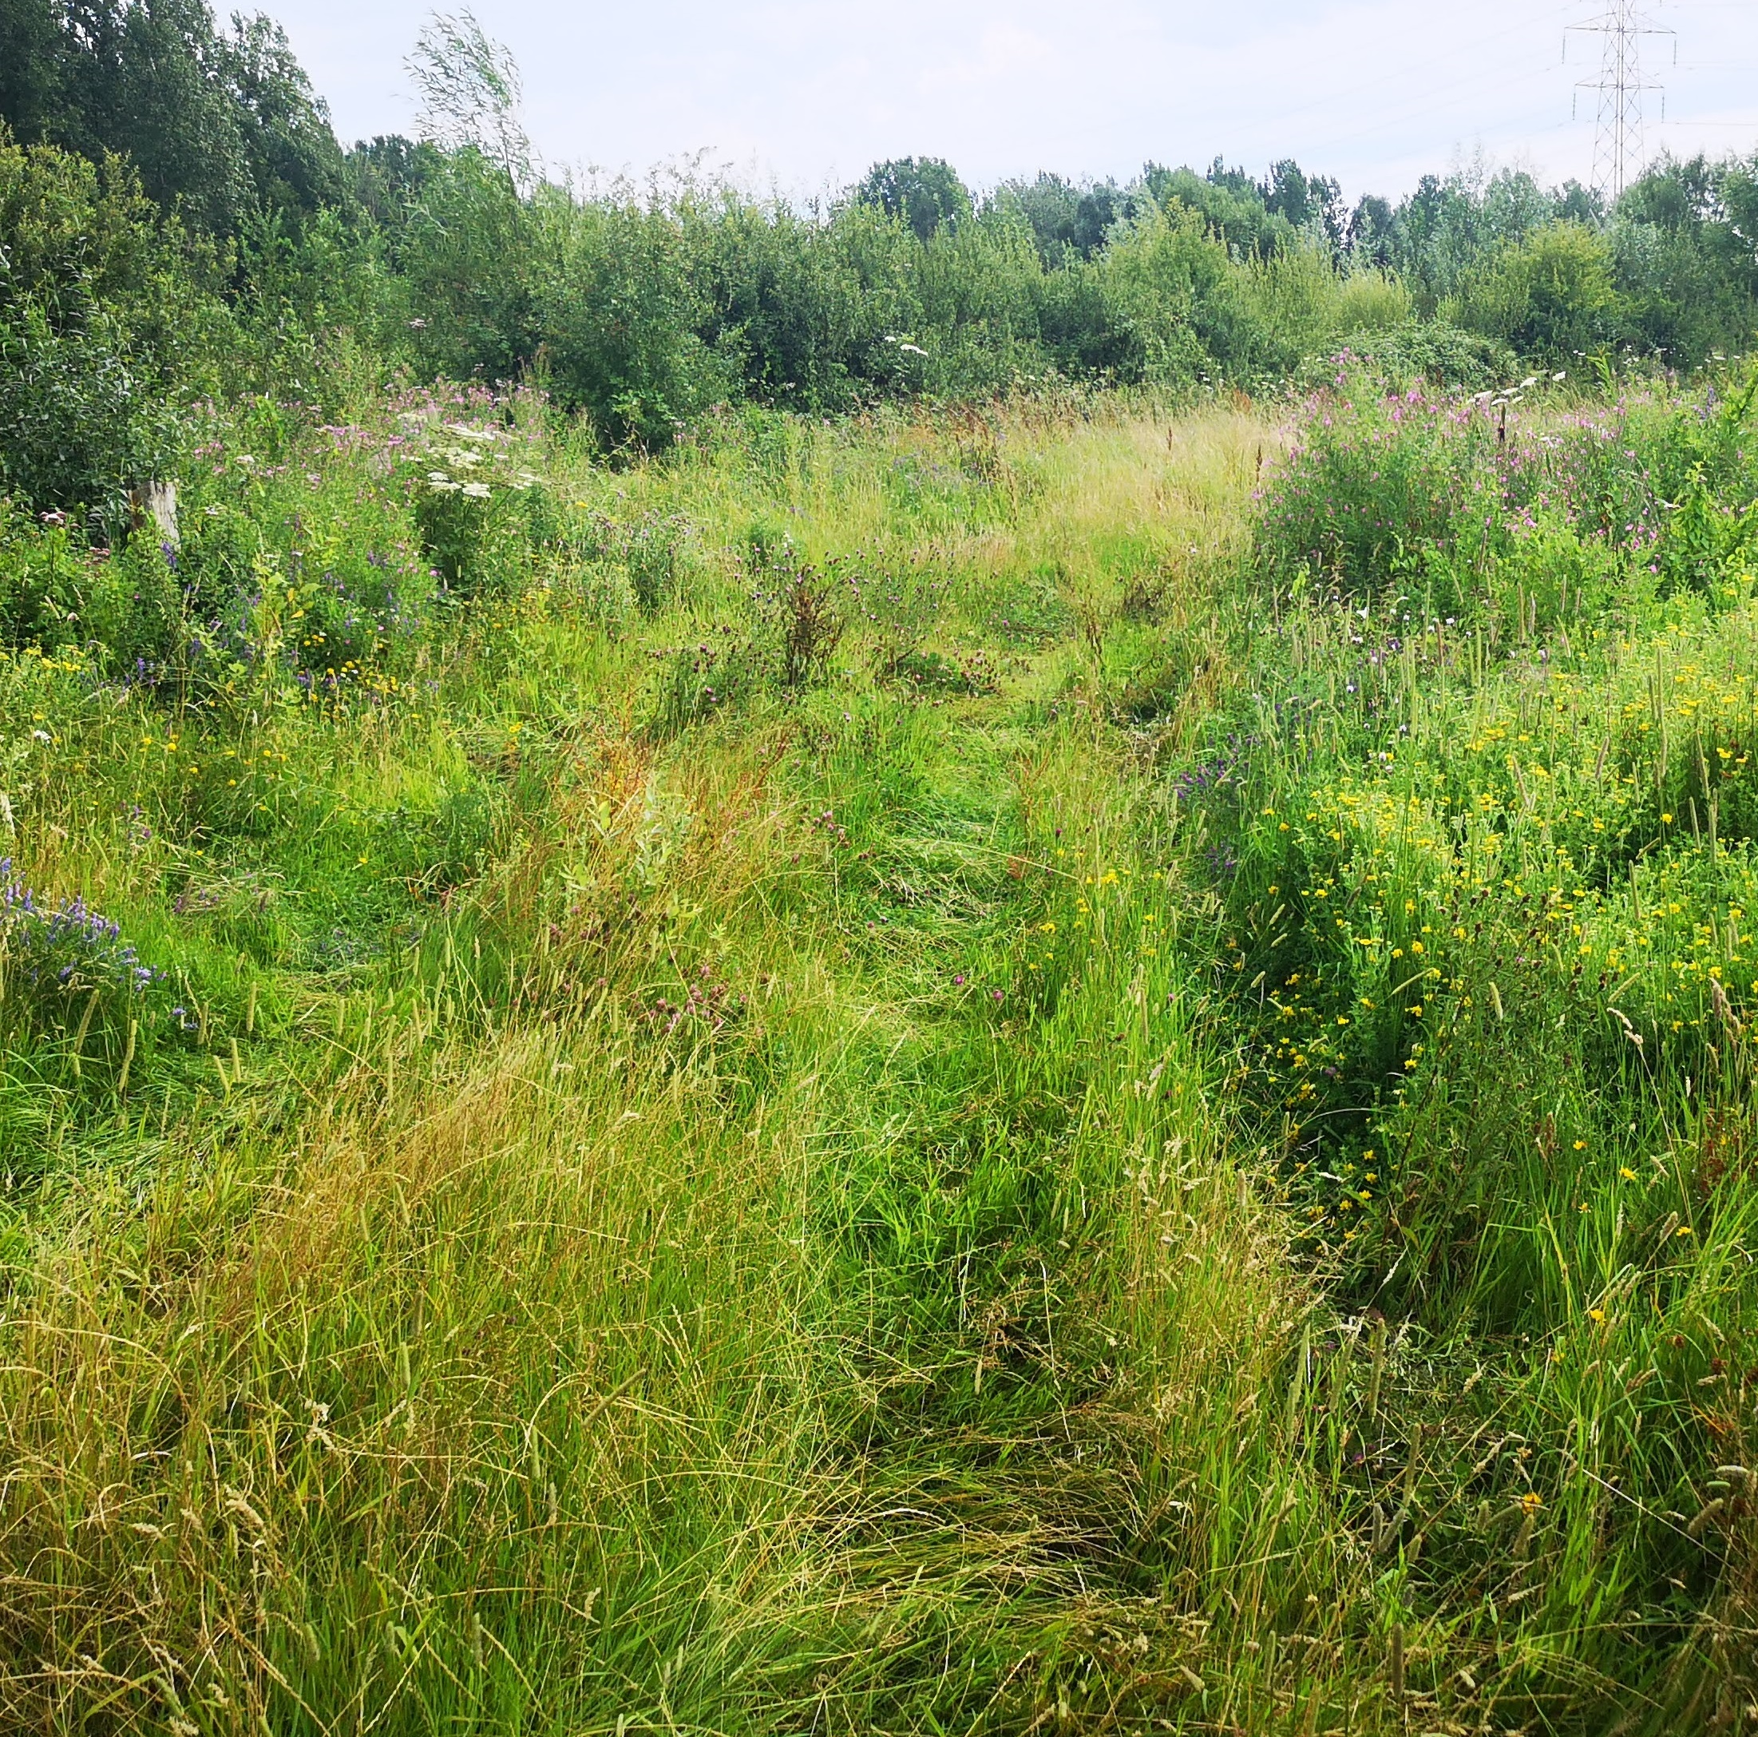
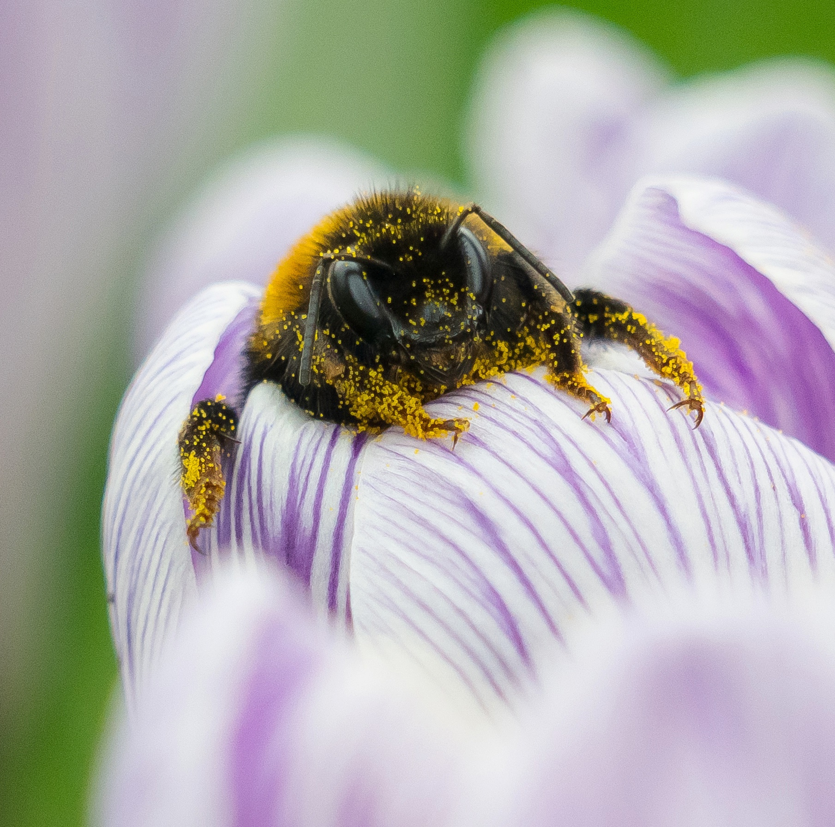
You can help bumblebees by….
Photo: Kate Jaconello
planting bumblebee-friendly flowers to make sure bumblebees have plenty of food
leaving a wild area in your outdoor space for bumblebees to nest and hibernate
telling everyone about how wonderful bumblebees are and how we can help them
bumblebeeconservation.org
Notes:
How can you help bumblebees?
The importance of our local outdoor spaces as bumblebee havens is more significant than ever. The good news is you don’t have to be an expert gardener to help bees; you don’t even have to have a garden! A window-box, balcony or hanging basket will do.
Fortunately, we can all provide vital support for bumblebees by creating bumblebee-friendly habitats. The easiest way to achieve this is to
Plant more bumblebee-friendly flowers in our local green spaces, such as gardens, parks and schools. This provides lots of food for bumblebees.
Leave a wild area. This provides spaces for bumblebees to nest and to hibernate.
Tell everyone how to help bumblebees. Giving other people the information they need to create bumblebee-friendly spaces means there will be more food and nesting sites for bumblebees.

Slide 9
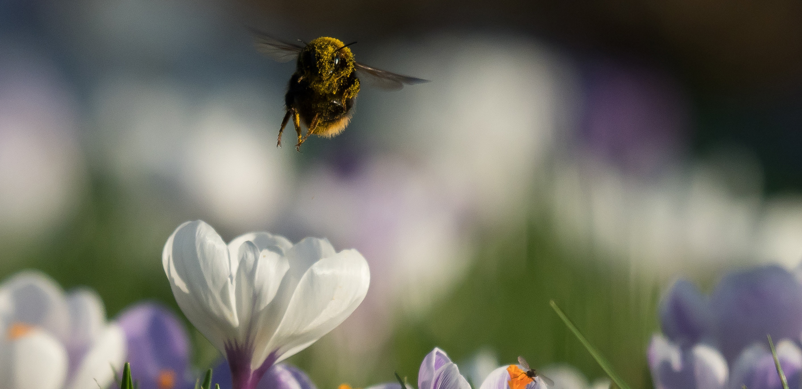
thank you
Photo: Kate Jaconello
bumblebeeconservation.org

Slide 10
some bumblebee extras….
bumblebeeconservation.org
Notes:
How can you tell apart a bumblebee from a honeybee? Where do they live? What do they do? And of course - do they both make honey? (Spoiler: no!) 🐝
Join our Education Officer Andy as he breaks down the top five differences between bumblebees and honeybees.

Slide 11
some bumblebee extras….
bumblebeeconservation.org

Slide 12
some bumblebee extras….
bumblebeeconservation.org
Notes:
Want to know more about the bumblebee story? When did they first appear? Join our Education Officer on a trip starting 140 million years ago!

Slide 13
some bumblebee extras….
bumblebeeconservation.org
Notes:
Our Education Officer, delves into the science behind static electricity, magnetism and how bumblebees and flowers have an electric charge which helps them both in the process of pollination.

Slide 14
March 2023. Copyright 2023 ©. All rights reserved.
The Bumblebee Conservation Trust is a registered charity (England & Wales 1115634 / Scotland SC042830). Company registration number 05618710 (England & Wales)
bumblebeeconservation.org

